Slide 1
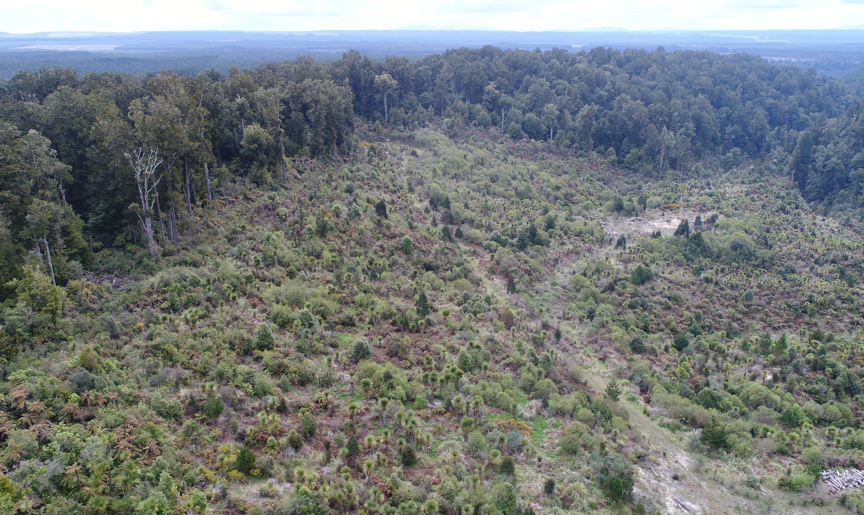
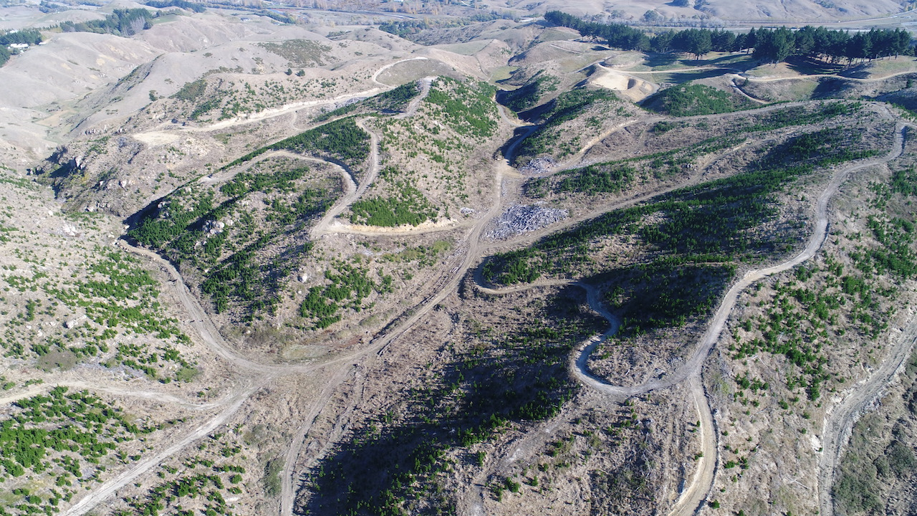


Restoring Native Forest on Plantation Clear-fells
Nelson City Council Forestry Workshop, May 2020
Prepared by Dr Adam Forbes, Forbes Ecology Limited
Notes:
Hello I’m Adam Forbes.
This talk is a part of the Nelson City Council Forestry Workshop series.
I will be speaking about how you might go about restoring a native forest cover in exotic plantation clear-fells

Slide 2
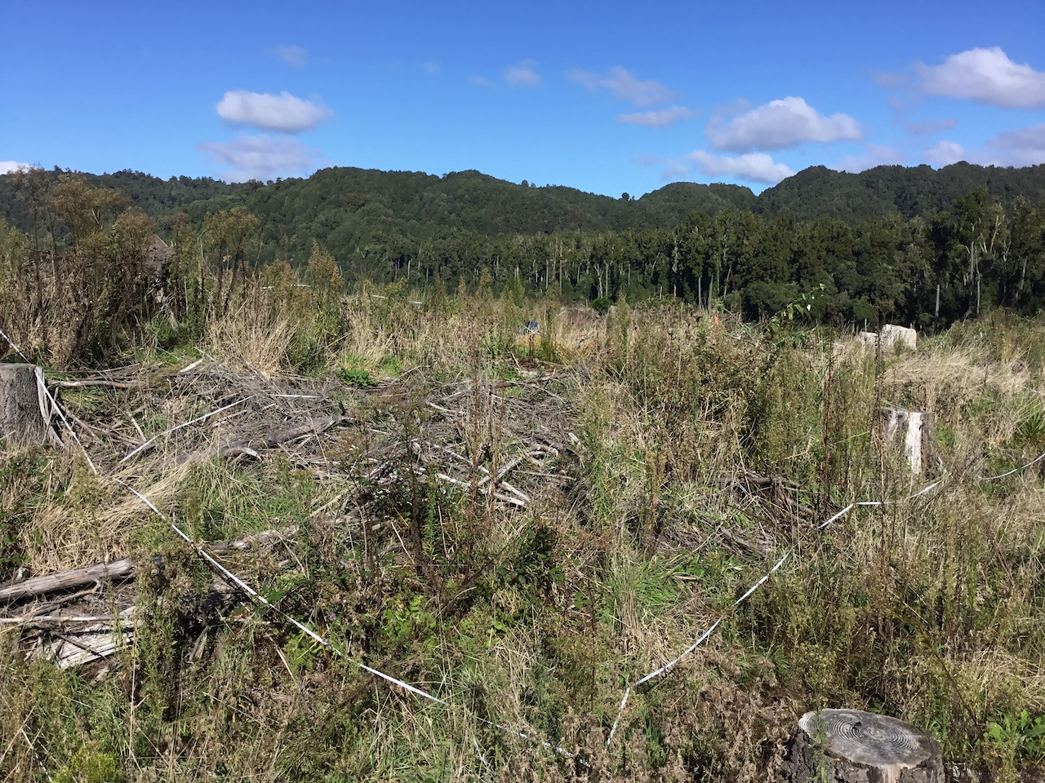
Presentation Outline
Introduction
  Opportunities
  Benefits
Management Considerations
  Objectives
  Climate gradients
  Site factors
  Herbivores and omnivores
  Seeds and dispersers
  Weeds
Restoration Approaches
  Locating your site on an active-to-passive restoration gradient
Case studies
  Active restoration – Tukituki, Hawke’s Bay
  Mixed active-passive restoration – Minginui, Bay of Plenty
Notes:
I will provide some background context on why someone may choose to restore native forest in plantation clear-fells.
Then I will describe what I see as the main considerations when tackling native forest restoration in clear-fells.
I will also describe a broad approach of categorizing how active or passive your inputs might need to be for a given site.
Then I’ll apply the management considerations, and the active-to-passive theory, to two case study sites where I have been working with landowners on clear-fell restoration.

Slide 3
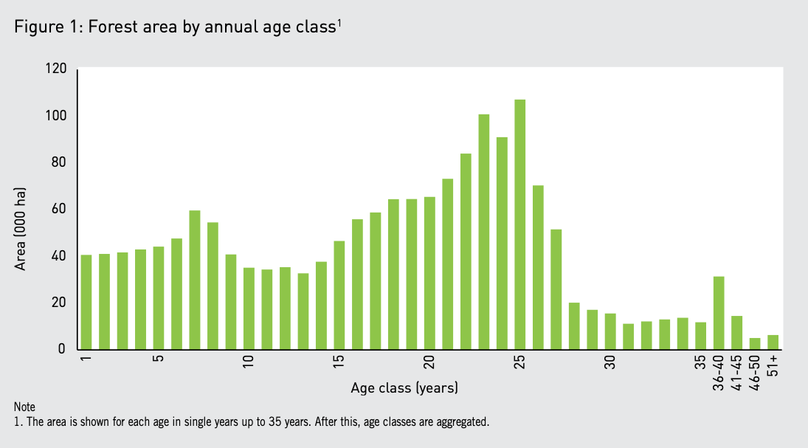
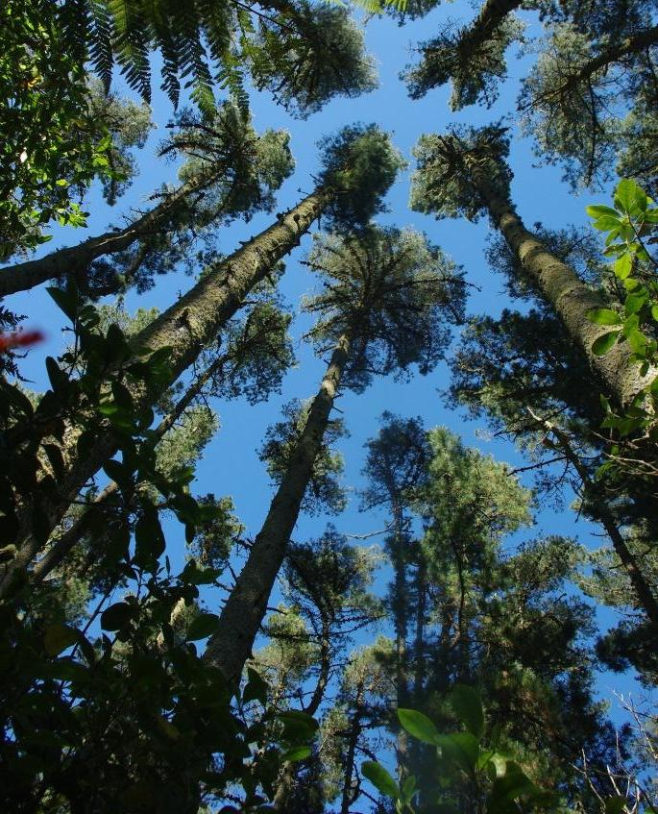
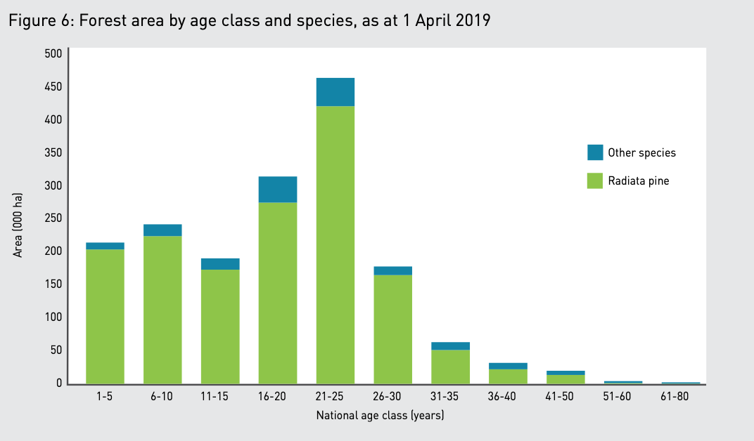
Opportunities
Significant national exotic plantation estate
Notes:
There is a lot of potential for native forest restoration in ex-plantation sites where land isn’t going to be replanted in exotic plantation species.
The top left plot shows that NZ has large land areas under plantations that are reaching harvest ages
The bottom left plot shows that most of NZ’s plantations are radiata pine.
So nationally the situation appears to be that we have large areas or radiata pine forest reaching harvest age, and in some instances, owners may be looking for other forest options for these sites.

Slide 4
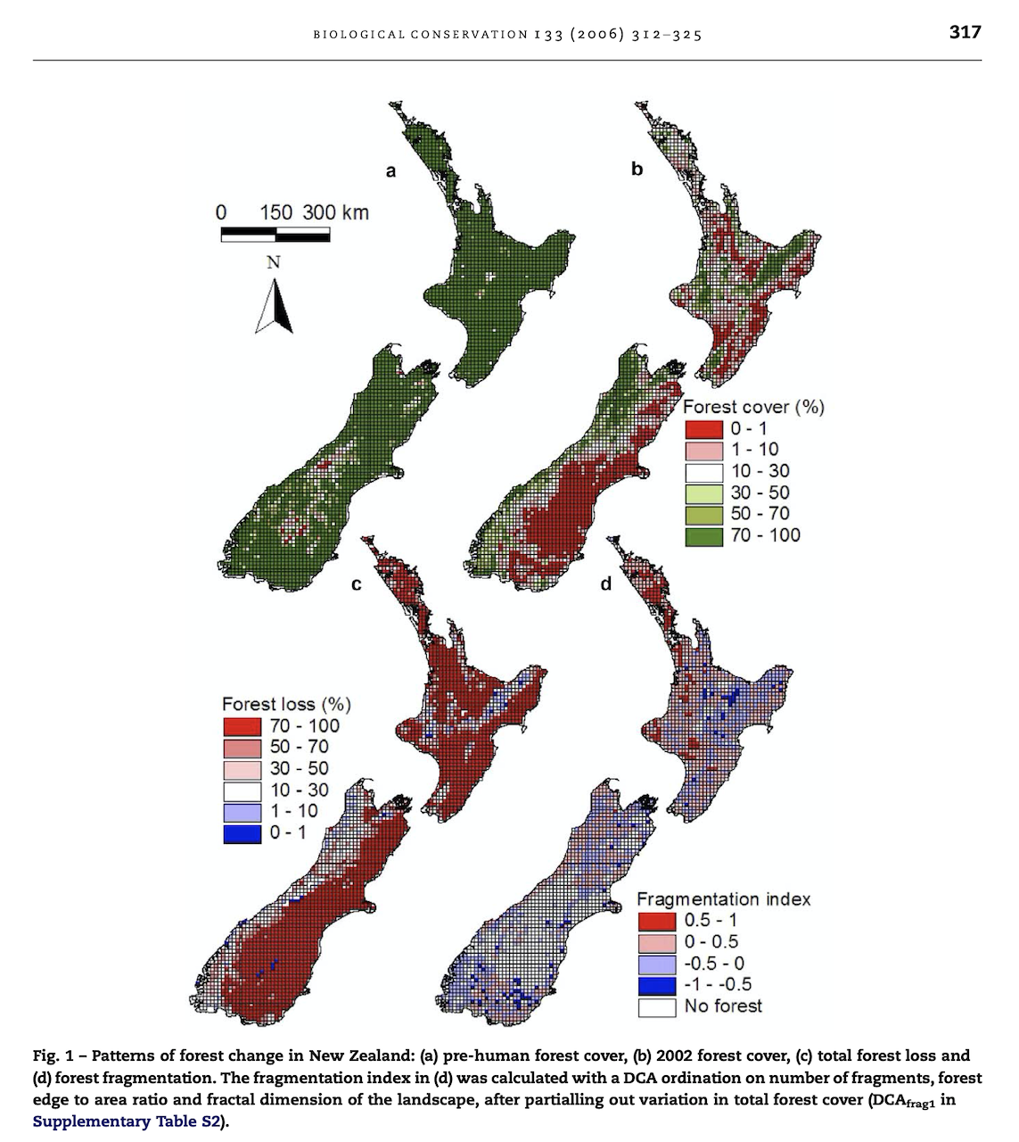
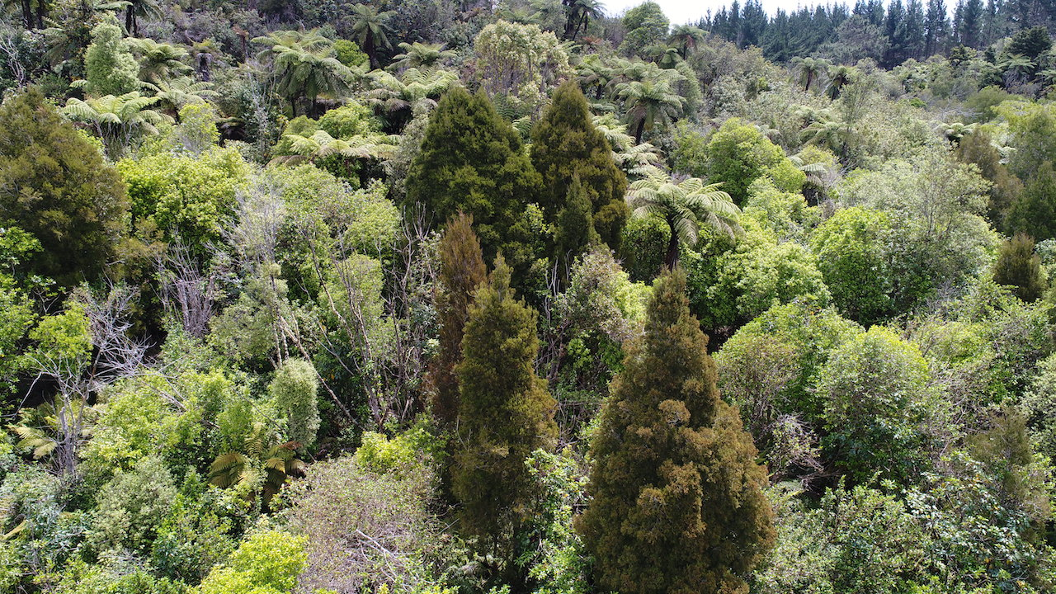
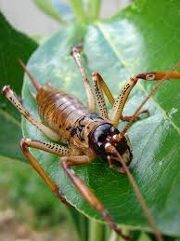
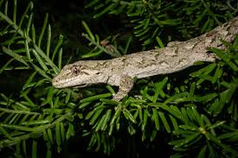
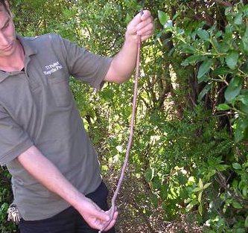
Opportunities
Large-scale restoration of permanent natural forest cover, and forest ecosystems
Ewers et al. (2006).
Notes:
The diagram on the right shows pre-human native forest extent compared to current extent.
Large areas of our native forests have been cleared, and these land use changes have had big impacts on issues like biodiversity and water quality.
So finding ways to restore native forest at larger scales is really important, and I think that is one of the exciting aspects of restoring native cover in clear-fells.

Slide 5
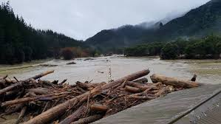
Opportunities
Māori cultural values of Ngahere (forest)^
Soil and water quality conservation
Food sources – kai o te ngahere
Learning – wānanga o te ngahere
Medicine – kapata rongoā
Schools – kura o te ngahere
Spiritual – wairua o te ngahere
^See:
https://www.landcareresearch.co.nz/__data/assets/pdf_file/0017/43910/maori_values_native_forest.pdf
Notes:
In addition to achieving scale in forest restoration, where are a number of other important opportunities that people can achieve from this type of restoration. For example, for Iwi, I’m aware that many aspects of the Ngahere (forest) are of cultural importance, such as provision of food sources, learning, medicine, schools, and spiritual aspects.
Also, if we can move land use away from clear-fell into permanent forestry, we can then reduce the risks to soil and water quality that can arise following clear-fell.

Slide 6
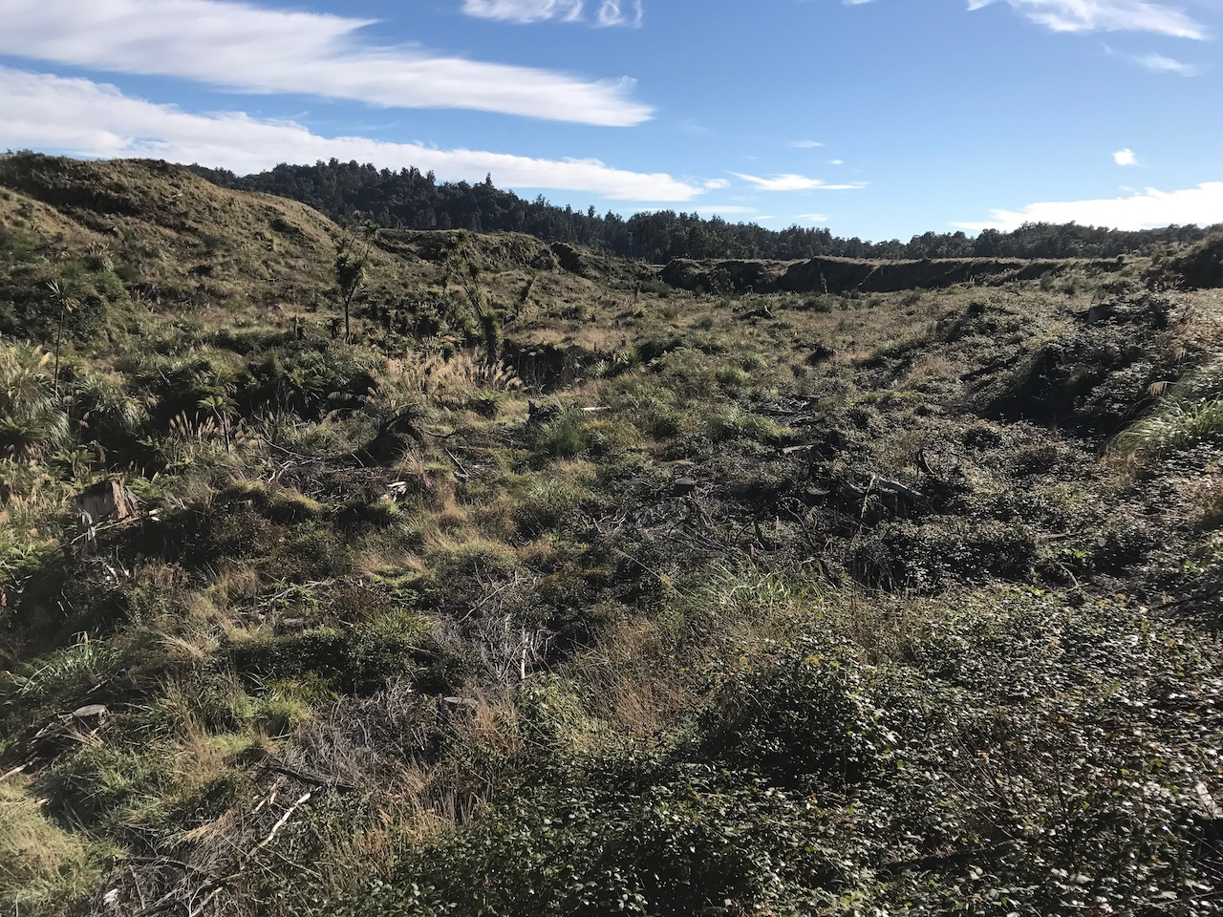
Management Considerations
Clear-fell restoration
Objectives
Weeds
Herbivores & omnivores
Climate gradients
Site factors
Seeds & dispersers
Notes:
Native forest is an attractive forestry option to many people, and I’m aware from my own work that landowners are interested in restoring native forest in clear-fells.
However, I find there are often lots of questions about how to go about restoration in these circumstances.
So to help people progress their planning, here I have bought together what I think are the main management considerations when planning restoration in clear-fells. I think these considerations will help land owners traverse a range of central issues when planning their clear-fell restoration project.
No doubt there will be room to improve this, especially as this type of restoration is more commonly practiced, and also as we progress the science around restoration of clear-fells.

Slide 7
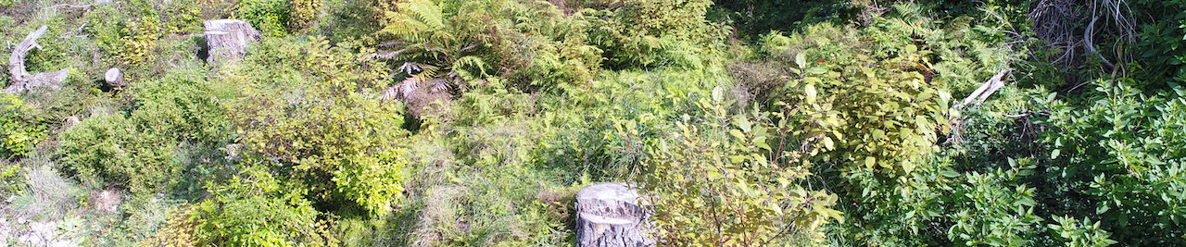
Management Considerations
Objectives
Develop a clear view about what you want from the clear-fell – start with a brainstorm!
Carbon forestry
Eco-tourism
Wildlife
Income streams
A restoration project
Water quality protection
Kererū, korimako, & tūī!
Not another pine forest!
Soil stabilisation
Natural heritage
Active or passive management?
Insect diversity
Hunting opportunities
Native species
Forest ecosystems
A positive legacy for your children’s children
Native timber
Develop SMART objectives: Specific, Measurable, Attainable, Relevant, Time-bound
Notes:
I encourage people to remember that forests are multi-dimensional – they can offer and support a multitude of values, functions and outcomes.
A good first step is to spend some time thinking, and talking with others, about what you would actually like from the vegetation on your clear-fell.
For example, for many obtaining an income stream is important – so things like carbon or native timber are good things to consider.
For other people, the objective might be more about nature, and setting up a diverse forest for future generations.
Others might be concerned about soil stability, and be wanting a permanent forest cover, and getting away from exotic rotational forests.
Once you have developed ideas about what you are wanting to achieve, then you might want to work those into some objectives, and ideally a management plan, so that the restoration project can be aligned with other aspects of your land management, such as annual budgets and work programs.

Slide 8
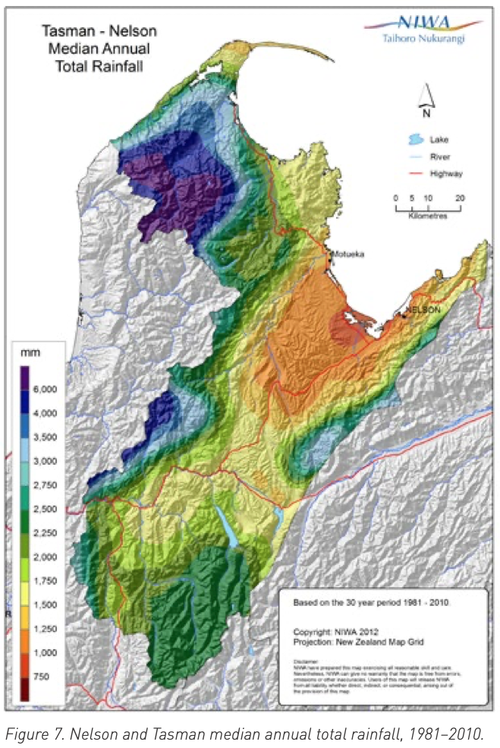
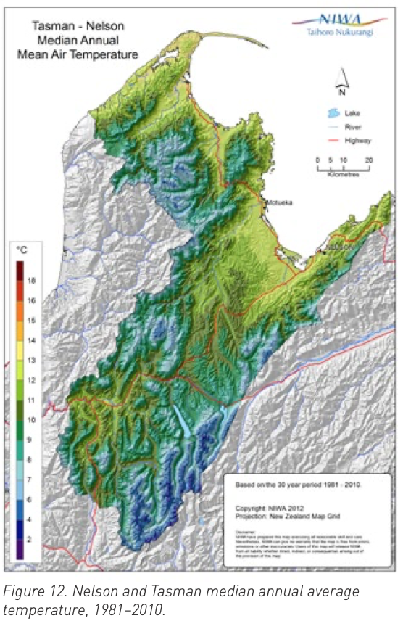
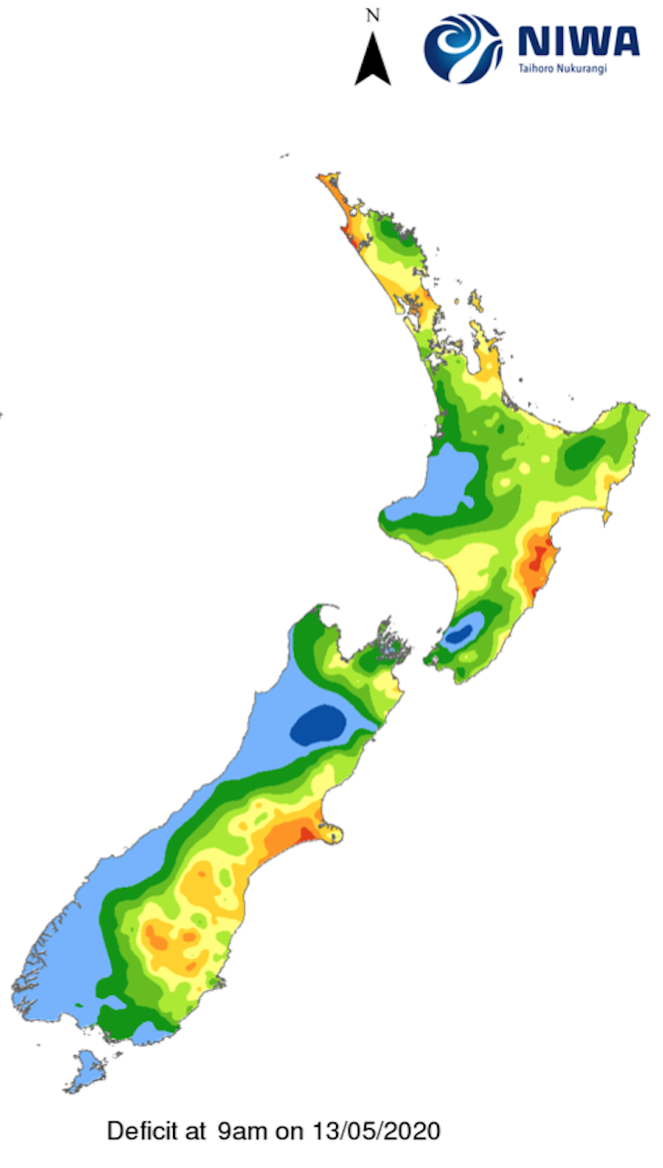
Rainfall
Air temperature
Management Considerations
Climate gradients
Soil moisture
Notes:
Understanding the climate of your clear-fell will help you understand what levels of management are likely to be required, and also which native species might be best for your location.
I’ve included the diagrams above, which show average annual rainfall and air temperature – information like this is very important for understanding forest regeneration and is therefore essential to understand when planning for your restoration project.

Slide 9
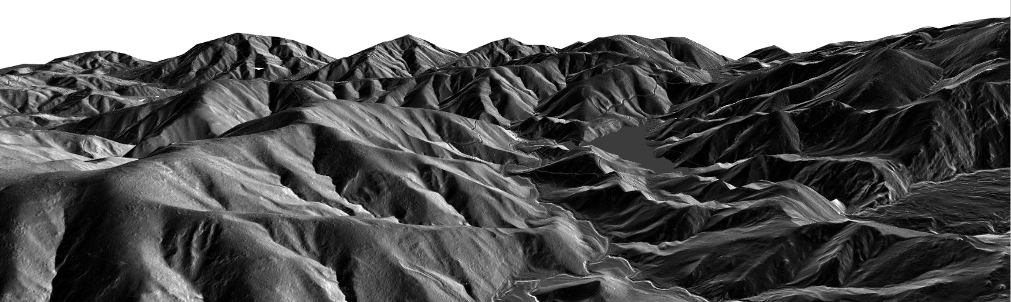
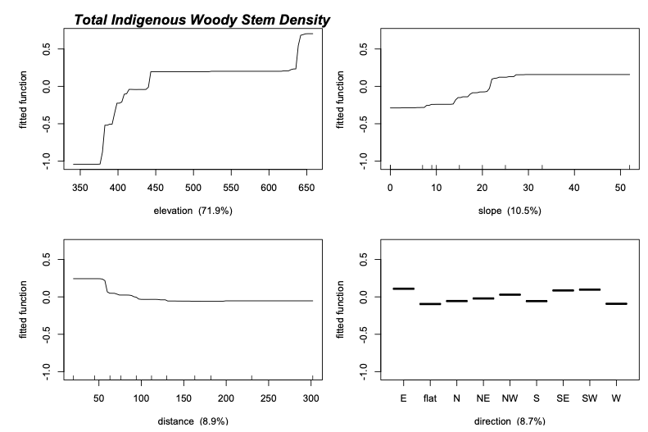
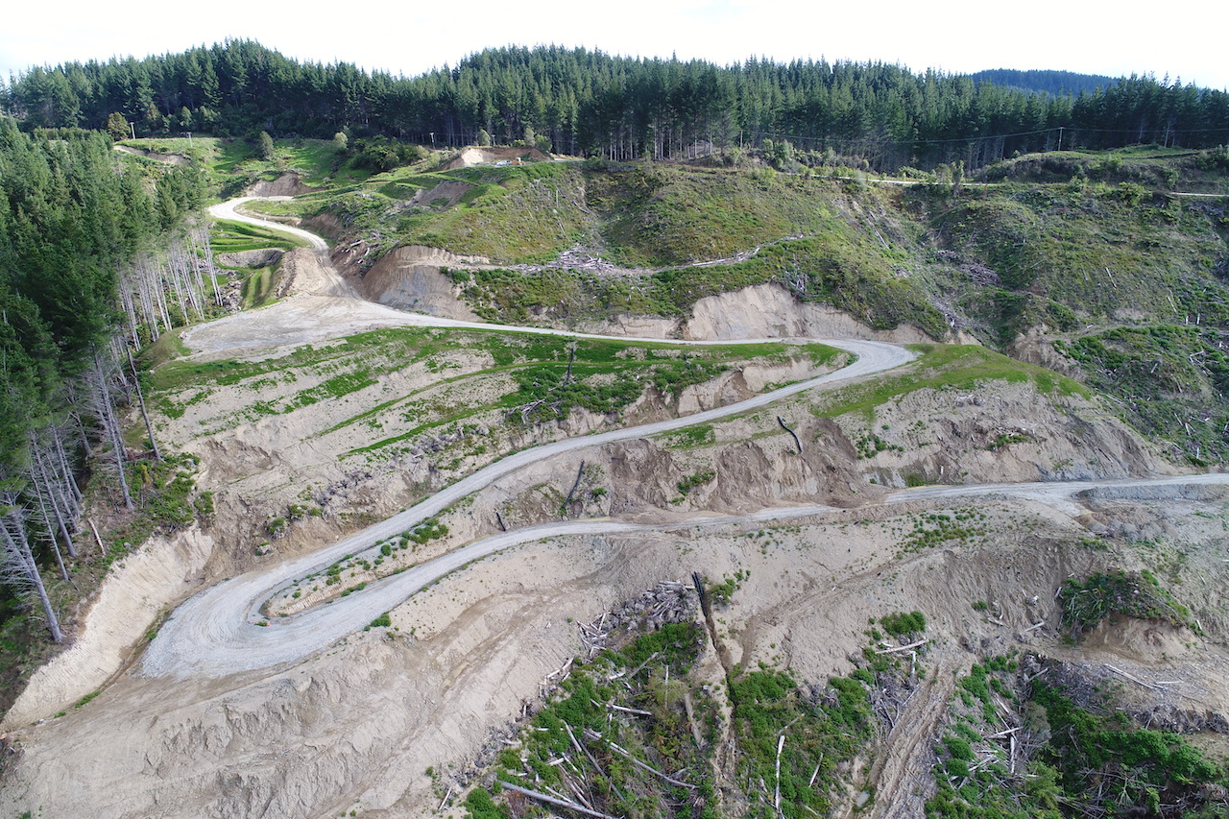
Management Considerations
Site factors
Elevation
Slope
Aspect
Physiography
Disturbance severity
Notes:
The types and range of land forms in your clear-fells are important as this variability determines things like micro-climate, and also some soil properties. For instance, you should have different expectations for what will occur naturally on a ridgeline, compared to a low position on a south-facing slope.
The plot at the bottom left shows modelled response curves from some of my survey data in clear-fells – the curves show how native tree density varies with the factors: elevation, slope and aspect/direction.
In addition, some aspects of clearfell can result in severe disturbance. As a principle, these severely disturbed areas are probably going to require a different and more intensive restoration treatment. For example, the photo in the bottom right shows significant tracking and benching. Skid sites are common in clear-fells also. Surfaces that have been benched or used as skids are likely to be compacted and regeneration will be much less or might not occur at all without ripping or planting seedlings.
You need to bring these details into your restoration planning.

Slide 10
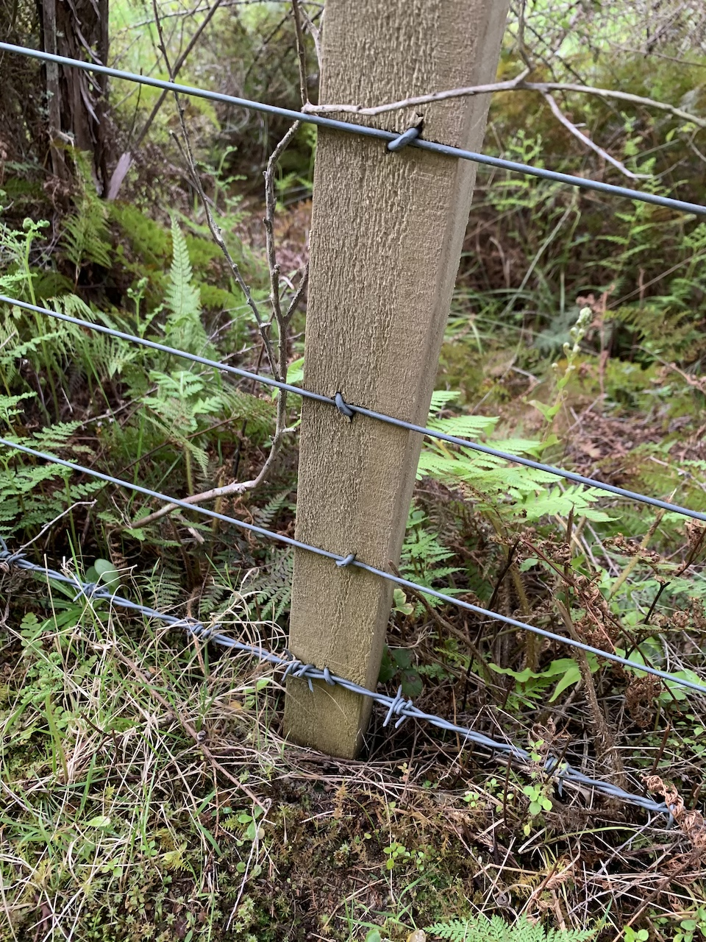
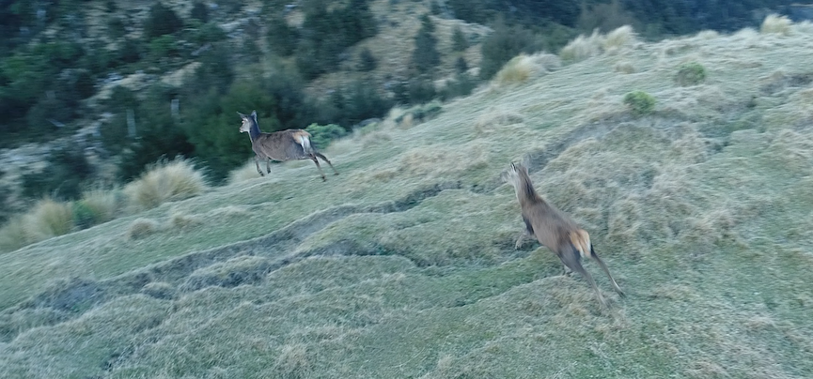
Management Considerations
Herbivores and omnivores
Notes:
It’s important to consider which feral herbivores are likely to visit your clear-fell. Animals, like goats, really need to be hunted to bring numbers down otherwise they could impact on the regeneration that occurs. Fencing is important, but remember that stock fences won’t keep out the feral herbivores – so either upgrading to higher fencing standards or teaming up with your neighbours to bring down animal numbers through hunting is a good option to consider.
Think about these fencing and hunting expenses as investments to ensure you have nice healthy regenerating forest.

Slide 11
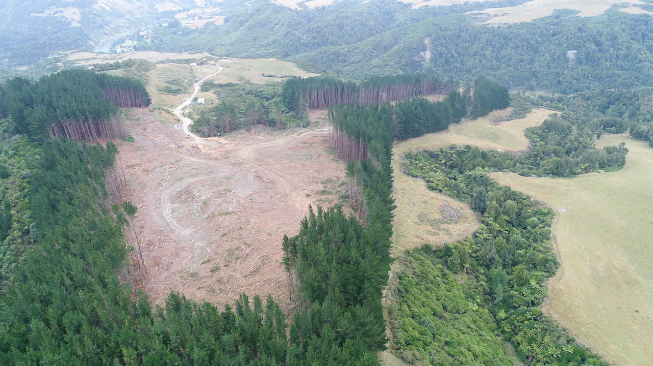
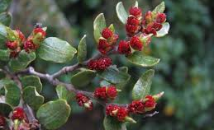
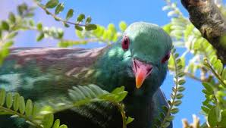
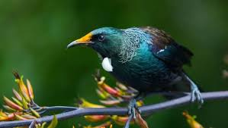
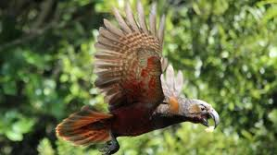
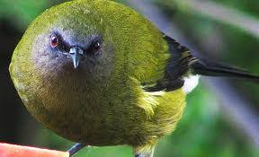
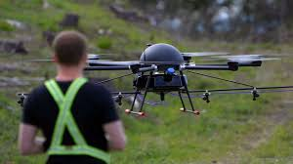
Management Considerations
Seed source proximity and dispersal
Kahikatea: animals, gravity
Look after existing seed sources – they provide an amazing range of ecological services
Beech: wind, gravity
Notes:
If you have native forest nearby, then it is possible that your restoration project will benefit from this, and in some circumstances, it might mean you can avoid planting native seedlings and instead rely on regeneration of native forest trees.
Look at the area within a few km of your clear-fell and see how much native forest there is, and also which species are in those forests. The best scenario is to have old-growth forest remnants close to the clear-fell, because many of the old-growth tree species are ineffective at dispersing their seeds over more than a few hundred metres.
Also think about the dispersal modes of the species found in the seed sources – are they wind dispersed or spread by animals?
Which bird species do you have – do you have species that will eat and spread native tree seeds?

Slide 12
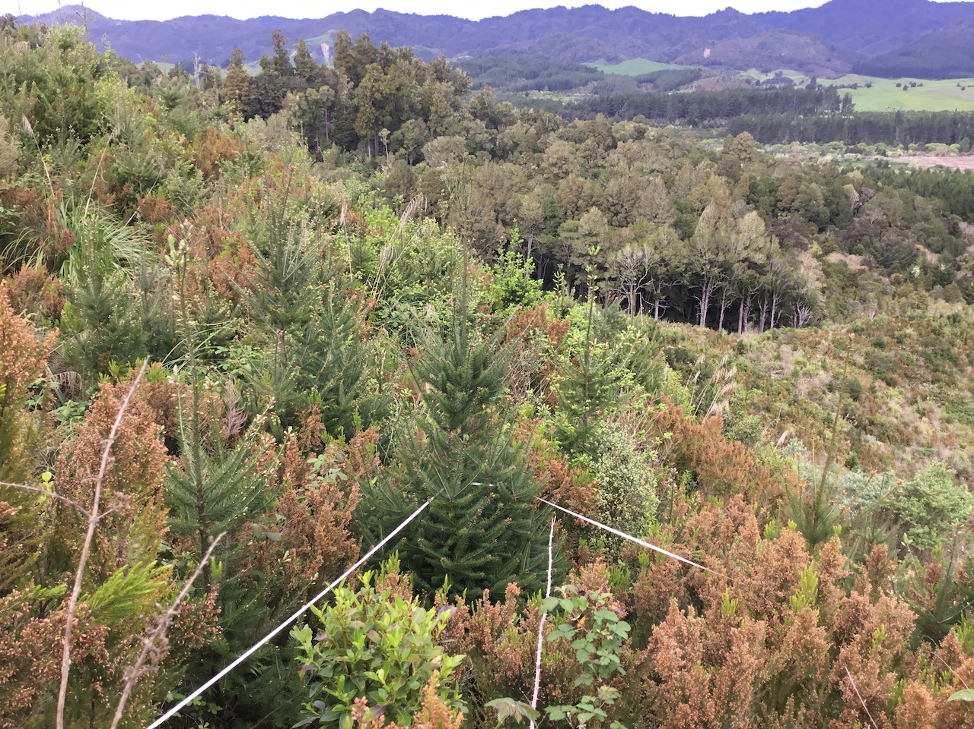
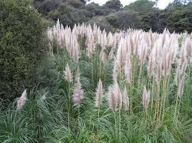
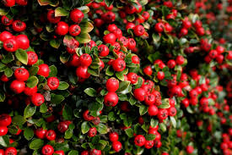
Management Considerations
Weeds
Which species are you contending with?
Light demanding
Shade tolerant
Radiata pine
Gorse
Pampus
Cotoneaster
Barberry
Ivy
What is your strategy?
To what extent is weed control necessary?
Where is the balance point between competition and facilitation?
How might this balance differ across the site?
Notes:
Following the disturbance of clear-fell, weeds can be common. Because weeds can compete with natives, think about which weeds are likely to reduce regeneration. ITt can be difficult to be sure when a weed has a positive or negative effect on a native seedling. For example, blackberry might be a real problem on floodplains, but not an issue on south-facing slopes where blackberry might be less vigorous, or the tree seedlings more vigorous.
Some weeds are light demanding, meaning that one option is to rely on native forest regeneration to outcompete the weed – whereas others, such as barberry, are shade tolerant, meaning you need to actively remove the weed rather than rely on shading.
Think about whether you can remove weeds manually, which can result in less disturbance, or whether you need to resort to chemicals.
Be vigilant with regard to biosecurity when people visit your site. Particularly during the plantation harvest and tracking activities, make sure contractors’ machinery and materials such as roading metal are free of weed seeds - as this is a common way weeds are spread around the landscape.

Slide 13
Categorising Clear-fells on an Active-to-Passive Gradient
Categorising Clear-fells on an Active-to-Passive Gradient
Plant to establish a canopy
High
High-density restoration planting, or
Mixed exotic-native planted system
Interventions
Install canopy trees
Enrichment: planting native or exotic species
Natural Regeneration
Manage a natural succession
Retirement: using exotic or native nurses
Low
Low
High
Notes:
This is a diagram I have put together to help with restoration planning.
Depending on how vigorous the natural forest regeneration is, you can expect to be more or less active with interventions, such as planting or weed control.
**Give example of high regeneration potential – managing natural succession – using passive methods

Slide 14
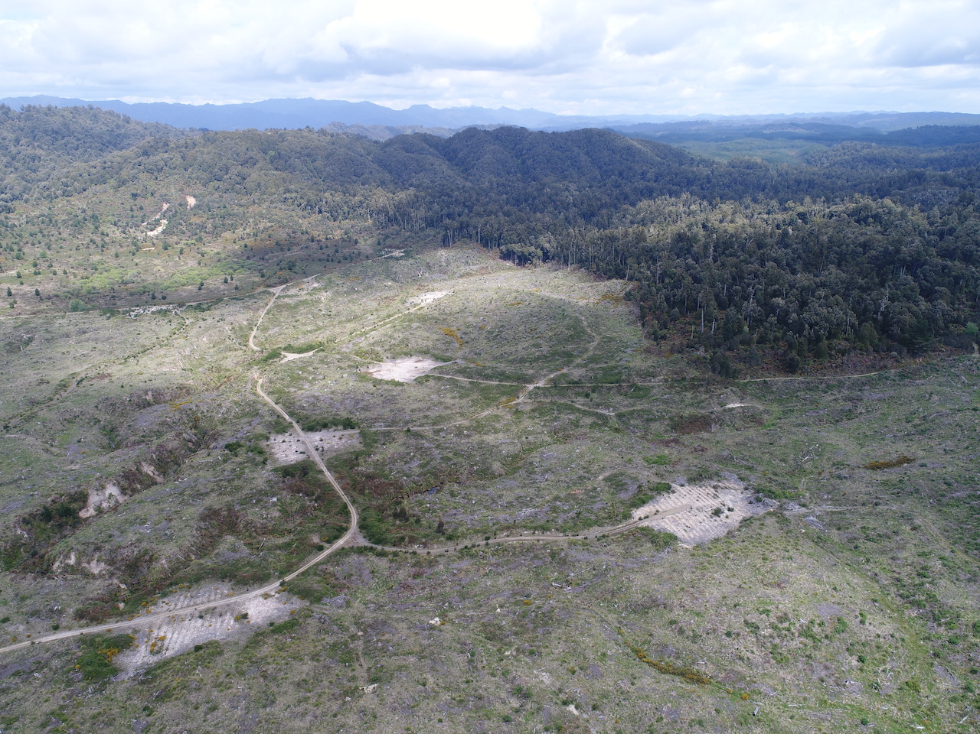
Case Studies
Notes:
Now I will apply the above management considerations in two case study sites which require contrasting restoration approaches
Both sites have featured past cover with exotic plantation species, and in both cases, the owners want to see a cover of healthy native forest on their clear-fell.

Slide 15
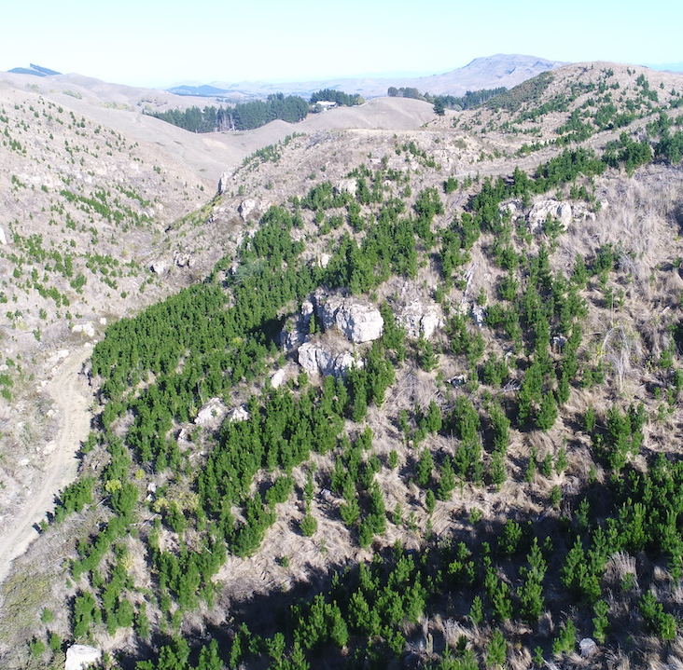
Objectives
  To restore native forest
    Ecology, amenity, recreation
Climate
  Warm, semi-arid, coastal
    Rainfall 818 mm/yr
    Temp 12.9 ℃
Site factors
  40–334 m a.s.l, variable topography
  Well drained, mod. drought vulnerable soils
Herbivores
  Hares, stock
Seeds and dispersers
  Poor proximity to seed sources
  Good populations nearby
Weeds
  Wilding radiata pine
  Blackberry
Case Study One
Tukituki, Hawke’s Bay
Notes:
Case study one is a coastal hawke’s bay site.
The owner wants a nice diverse native forest for restoration of biodiversity and for people that live nearby to enjoy.
The climate is warm and semi arid, soils are moderately drought vulnerable.
There are no real seed sources nearby in the landscape. Also the regeneration of wilding pines is dense. So natural regeneration is weak at this site.
In addition to the pines, there are patches of blackberry and the neighbors farm has gorse patches on the adjacent paddock.

Slide 16
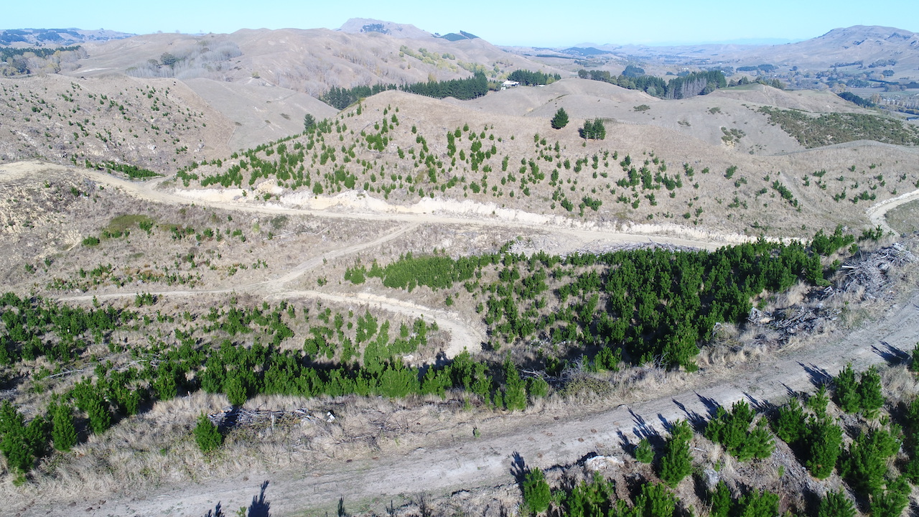
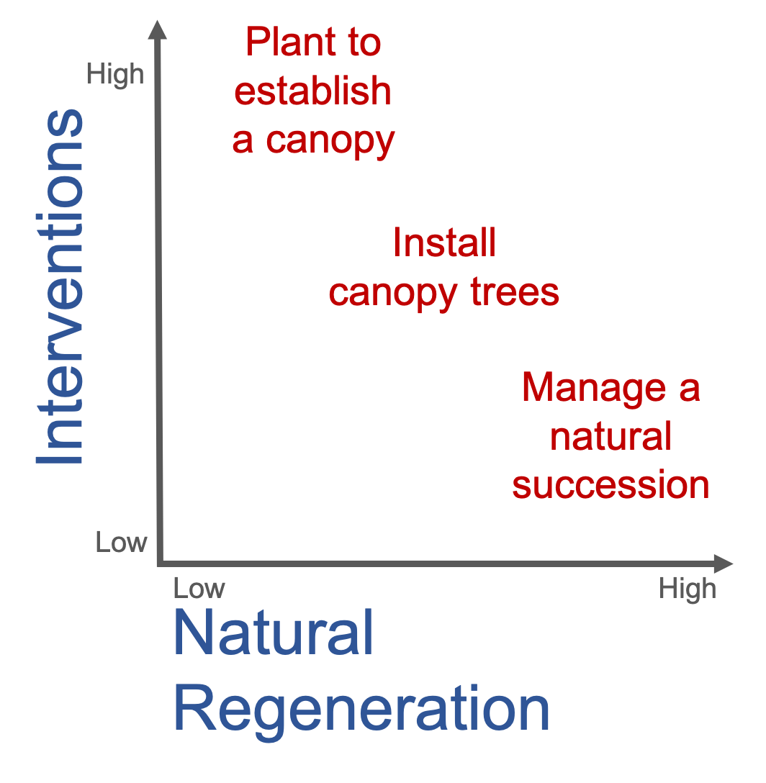
Case Study One
Tukituki, Hawke’s Bay
Restoration approach:
Weak natural regeneration – requires active restoration
Notes:
Because of the weak natural regeneration at this site, restoration will require high levels of planting and weed control.
On the active-to-passive plot – the owners should expect to be dealing with issues in the top left of the diagram shown by the blue arrow.

Slide 17
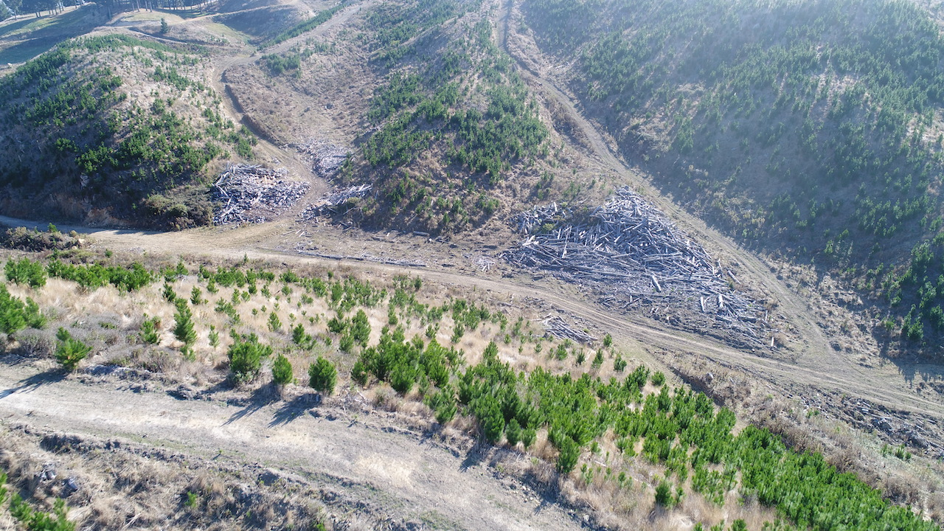
Case Study One
Restoration approach
Species |  | Coastal forest restoration planting
 |  | 49 ha | 1600 stems ha
 |  | Composition | Total number
Ngaio | MYOLAE | 0.65 | 50960
Five finger | HEDARB | 0.1 | 7840
Kōhūhū | PITTEN | 0.05 | 3920
Māhoe | MELRAM | 0.05 | 3920
Ralph's kōhūhū | PITRAL | 0.04 | 3136
Tītoki | ALEEXC | 0.025 | 1960
Lowland tōtara | PODTOT | 0.025 | 1960
Mountain flax^ | PHOCOO | 0.01 | 784
Karamū | COPROB | 0.01 | 784
Kahikatea* | DACDAC | 0.01 | 784
Cabbage tree | CORAUS | 0.01 | 784
Large-leaved kōwhai^ | SOPTET | 0.005 | 392
Māpau | MYRAUS | 0.005 | 392
Mātai* | PRUTAX | 0.005 | 392
Nīkau* | RHOSAP | 0.005 | 392
 |  | 1 | 78400
Note: ^focus around limestone outcrops. *Concentrate on valley floors.
Animal pest control | Weed control | Restorative planting
Rabbits and hares | Radiata pine | Ecosourced natives
Fence and retire stock | Blackberry | 1600 stem/ha (2.5 × 2.5 m)
Notes:
Before planting, the landowner needs to address rabbits and hares, and remove stock.
Removing the wilding pine regeneration is essential, and doing this without disturbing the ground I think is important so other weeds or more pines don’t establish in disturbed areas. The stock will have been containing the blackberry, so it is important to eradicate this early.
Planting at this site will include ecosourced species that are drought tolerant and that rapidly grow to outcompete the wilding pines and other weeds. Wave of widling control will be need in years to come, but early shade should limit this.
Natives will be planted at 1600 stems per ha, in a staged manner across the clear-fell.
Skid sites and unused tracks will be ripped prior to planting.

Slide 18
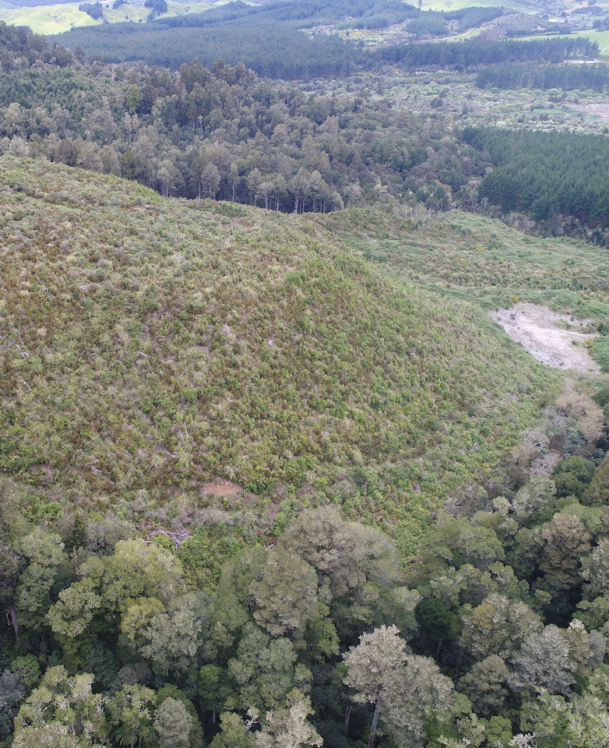
Objectives
  To restore native forest
    Ecology, cultural
Climate
  Cool, super-humid, frosty
    Rainfall c.1500 mm/yr
    Temp 11 ℃
Site factors
  320-658 m a.s.l, variable physiography
  Well drained soils
Herbivores
  Deer, possums, hares, rabbits, horses, pigs
Seeds and dispersers
  Excellent seed source proximity
  Abundant dispersers
Weeds
  Wilding conifers
  Blackberry, buddleja, Spanish heath
Case Study Two
Minginui, Bay of Plenty
Notes:
Case study two is actually a collection of clearfells located near Minginui in the central north island.
I completed some research for Ngati Whare who were wanting to restore podocarp forest on their land.
At this location and did a large vegetation survey across 200 ha of clearfells and then modelled the results to determine the extent of areas needing planting and weed control. This was quite an expense project, but for large clear-fell areas this work would help increase certainty over what levels of planting and weed control interventions are required.
The climate of the site is cool, super humid, and frosty. Rainfall is plentiful for NZs rainforest species to regenerate. There is more that 300 vertical m elevation gain across the site, and the highest points surveyed were over 650 m a.s.l.
This area is extensive – with 1000s of ha of natural and plantation forest adjacent, and there are lots of feral herbivores.
Old-growth forest surrounds all of the clearfells, so seed sources and bird populations are excellent.
The main weeds are exotic conifers, blackberry, Buddleja, and Spanish heath.

Slide 19
Restoration approach:
Generally good native woody regeneration (3855 stems/ha)
Wilding conifers throughout
Other localised weed issues
Suitable for a mix of active and passive restoration
Case Study Two
Minginui, Bay of Plenty
Notes:
Because of the good levels of natural regeneration at these clear-fells, a more passive approach to restoration is feasible. Planting is more necessary at lower elevations, on flat sites, and at locations more distant from seed sources. There were quite predictable patterns in weed cover. For example blackberry cover was greatest on flat low-elevation sites.

Slide 20
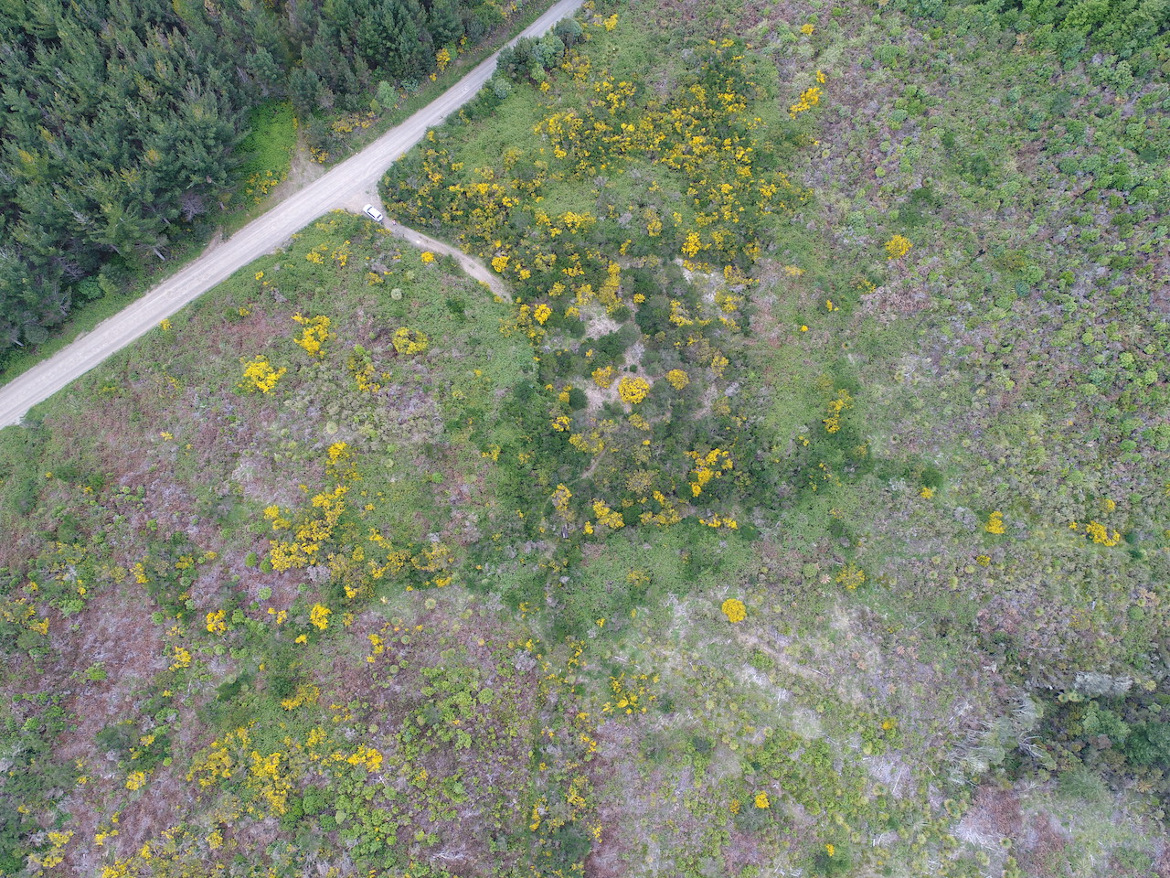
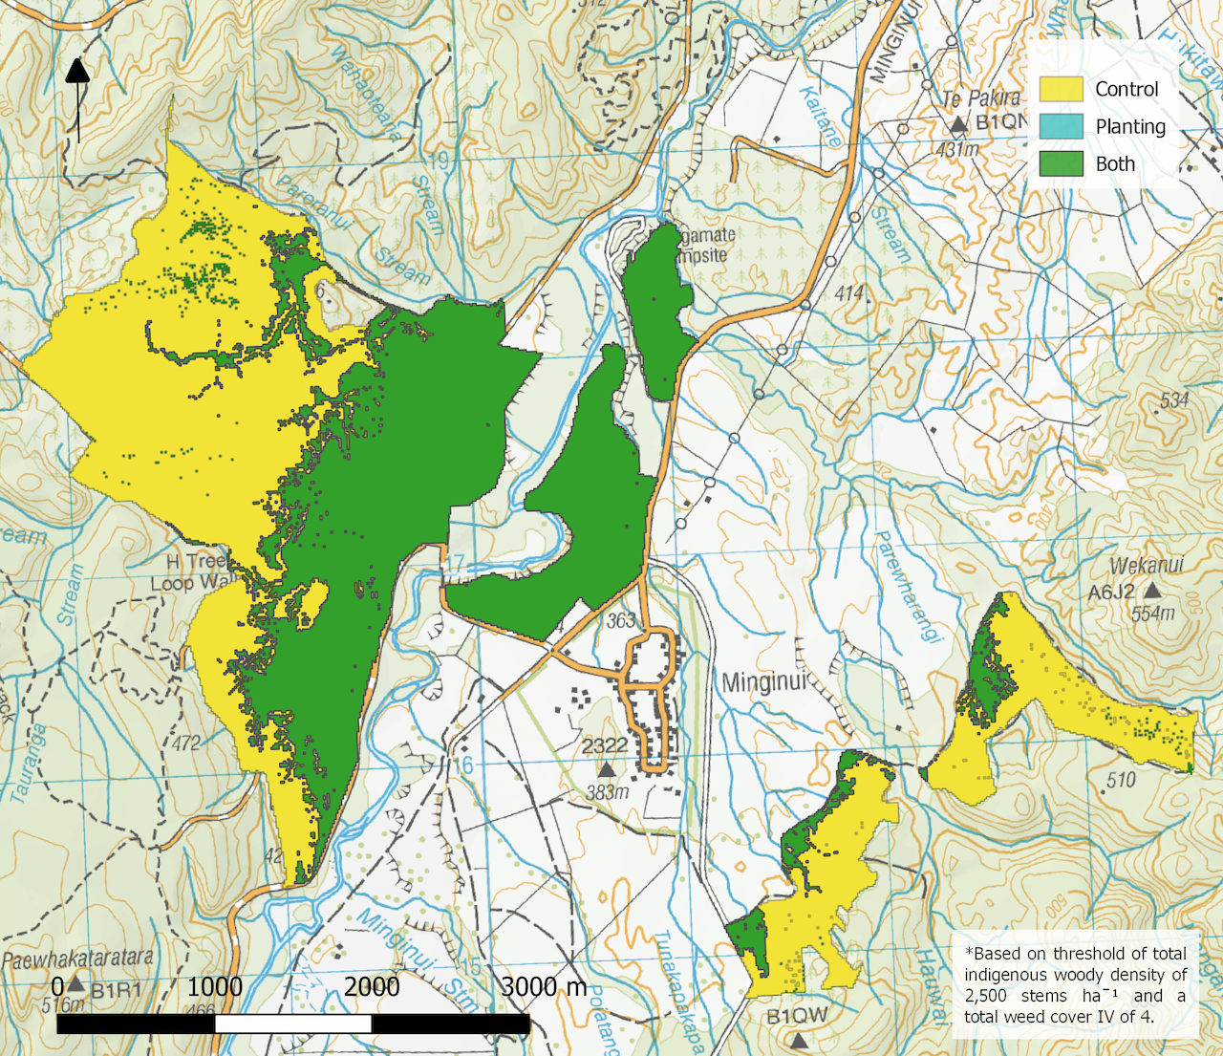
Case Study Two
Minginui, Bay of Plenty
Forbes, A. S. (2018).
Forbes & Allen (2020).
Notes:
The modelling work resulted in clear restoration prescriptions for planting and weed control, which was a great help for restoration planning.
However, the work also highlighted that we don’t have a good understanding over what levels of weed control are actually problematic for native regeneration and we need to study the demographics of forest regeneration in clear-fells, to understand the interactions with weeds, and when the weeds are beneficial versus detrimental to regenerating native forests.

Slide 21
Summary
Restoring native forest in plantation clear-fells
Clear-fell restoration
Objectives
Weeds
Herbivores & omnivores
Climate gradients
Site factors
Seeds & dispersers
There is growing interest in restoring native forest on plantation clear-fells
The issues and approaches for restoration are will vary among and within sites
A range of considerations are developed here to help guide decision making for forest restoration in clear-fells
Levels of interventions (planting and weed control) will vary among sites and the active-to-passive gradient provides a useful means of categorizing the restoration approach
Notes:
In summary, I think there is a growing interest in restoring native forest in clear-fells.
We need to do more work to understand this type of restoration better, as this makes the proposition clearer and more certain for people.
Here, from my experience, I have put together a group of considerations that I think will help you plan restoration in your clear-fell.
I hope this is useful and also helps stimulate some discussion amongst landowners on this project.
I’m happy to answer any questions at any time.

Slide 22
Contact Details:
Forbes Ecology Limited
Dr Adam Forbes
adam@forbesecology.co.nz
www.forbesecology.co.nz
References:
Ewers, R. M., Kliskey, A. D., Walker, S., Rutledge, D., Harding, J. S., & Didham, R. K. (2006). Past and future trajectories of forest loss in New Zealand. Biological Conservation, 133(3), 312-325.
Forbes, A. S. (2018, July 28). Evaluation of regeneration potential project [blog post]. Retrieved from http://www.forbesecology.co.nz/blog/article/evaluation-of-regeneration-potential-project-report-7/
Forbes, A, S., & Allen, R. (2020). Determining the balance between active and passive indigenous forest restoration after exotic plantation clear-fell. Manuscript in preparation.
Marlborough District Council. (2016). Guidelines for converting pine plantations to native vegetation in the Marlborough Sounds. Retrieved from https://www.marlborough.govt.nz/repository/libraries/id:1w1mps0ir17q9sgxanf9/hierarchy/Documents/Environment/Biodiversity/Guidelines%20for%20Pine%20Plantations%20List/A%20Pines_to_Native_Guidelines_Website_Reading_Website.pdf
Ministry of Primary Industries. (2019). National exotic forest description. Retrieved from https://www.mpi.govt.nz/dmsdocument/34425-2019-nefd-report-pdf

