Slide 1
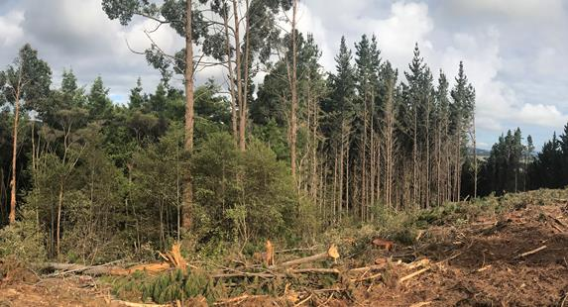
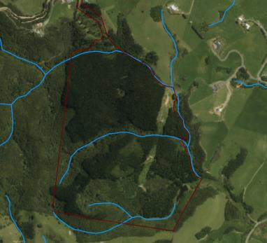
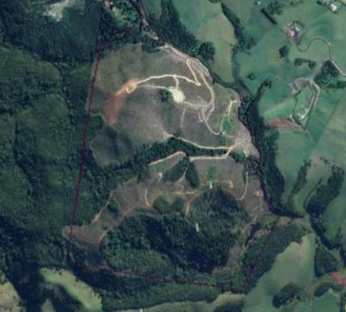
Using pre-harvest and harvest actions to enhance conversion to native ecosystems
Notes:
This presentation focuses on how to get the most help from natural regeneration (without planting) – this is the ‘passive’ end of Dr Adam Forbes’ ‘Active to passive’ intervention gradient. So I hope it is complementary!
Most slide with photos will have a brief description in the notes, which I hope are useful examples
Photo: This pine forest is in the process of being harvested; a native shrubland remnant is on the LHS (some eucalyptus were planted through it and have not been harvested with the pines) where a tree has been felled into the natives, unnecessarily squashing them (which is dumb – removing the canopy creates a site for weeds to compete more effectively, and reduces native seed production).
The harvesting process has de-limbed where each pine is felled, and this creates a cover that protects the soil from erosion

Slide 2
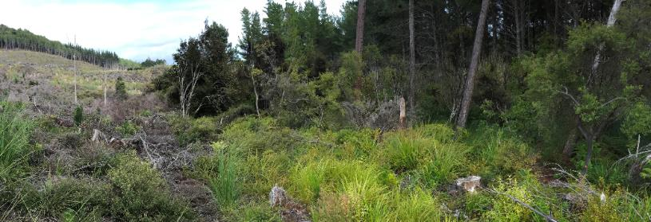
Presentation outline
This presentation suggests:
Principles for ‘no regrets harvesting’
‘No regrets’ harvesting keeps the end game of native restoration front and centre to avoid missed opportunities
Planning steps that maximise cut-over values for native ecosystems and minimise total costs (some pines are more valuable unharvested – killed standing)
Notes:
I’m covering two main aspects.
First
Principles for ‘no regrets harvesting’.. This is harvesting keeps the end game of native restoration front and centre to avoid missed opportunities
Second
Planning steps that maximise cut-over values for native ecosystems and minimise total costs. Some pines are more valuable unharvested for the jobs they are providing – for example as erosion stabilisers, protectors of waterways, as a nurse to natives or supressors of nastier, more intractable weeds.
Photo: About 12 months after harvesting of pines, north of Dargaville. Typically, most native regeneration is near the remnants (here a seepage leading to small stream) and at the edges of compartments where the physical damage from harvesting operatons is minimised.

Slide 3
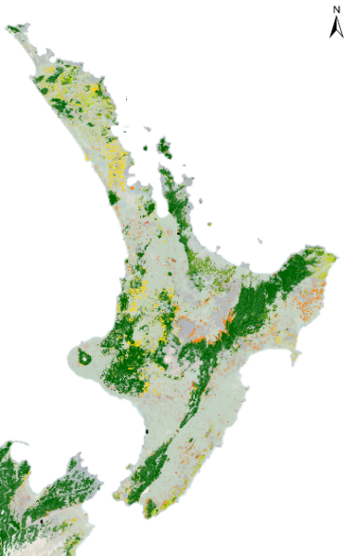
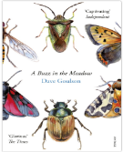
Why native ecosystems?
NZ lowlands are our biodiversity red zone: they contain many highly threatened native ecosystems and only small areas are formally protected.
‘ Conservation is not something that should be left to others… but as an individual it is very hard to know where to start – it all seems so remote and dauntingly complex.’
‘but … a farmer or policy maker or warden of a nature reserve can make a world of difference’ ¹
¹Dave Goulson ‘A sting in the tale’ 2013, ‘A buzz in the meadow” 2015
Notes:
Dr Forbes showed a wealth of reasons more and more people are wanting to convert pines to natives
At a national and regional level, the most important reason is that we have so little of our unique heritage left, especially in the lowlands.
The second reason is that as landowners, we can do it ourselves – we can make a difference.
This map shows what native plant cover remains using LCDB4 and rates it my how threatened it is; the yellow, orange and red colours show the native remnants that there is not much left of – unsurprisingly these are mainly in areas where pasture grows well, and most of it is on private land
Reference: Threatened Environment Classification https://www.landcareresearch.co.nz/resources/maps-satellites/threatened-environment-classification
You can view it (free) on an online GIS tool from this website

Slide 4
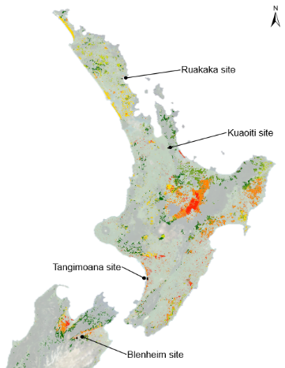
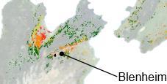
Plantations can support native ecosystems
‘About 354,000 ha (17%) of plantations are on land that could support NZ’s most threatened environments
Remnant plants occur as:
Outcrops and steep areas
Riparian zones and wetlands
Understorey regeneration (due to stock exclusion)
Isolated large trees, espec. on ex-farmland
Notes:
As plantation forest owners, we’re especially fortunate because
a) Many forests have native remnant vegetation patches within them (typically 10-20% in central NI forests?)
b) The pines and natives are often in areas where there is the least left – so where the remnants, and new restoration of natives are most ecologically valuable
This map shows
‘Exotic forests’ cover in NZ, overlaid with Threatened Environment Classification of NZ. So it shows only at land with plantation forestry currently (lots of red and orange = highest-threat sites) – the inset is an enlargement of Nelson/Blenheim area with Blenheim being a case study site (not the town!)
I lead a research project where we looked at four case study sites to assess the potential benefits of pine plantations for native biodiversity.
Remnant plants and ecosystems are often found as
Outcrops and steep areas
Riparian zones and wetlands
Understorey regeneration (due to stock exclusion)
Isolated large trees, espec. on ex-farmland

Slide 5
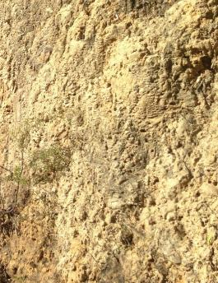
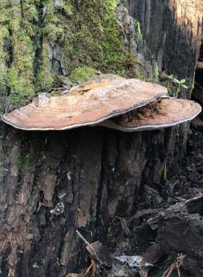
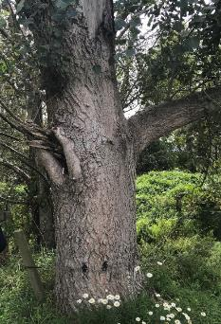
Native plants are just part of our biodiversity
Other biodiversity features
Stumps, snags and large dead wood support insects, fungi and epiphytes (lichens, mosses and plants). Don’t tidy or burn, instead cut tall and retain in low, moist piles
leaf litter and soils, especially those never ploughed (or grassed) support the bulk of our invertebrate biomass, mycorrhizae
Native bee banks
Notes:
Also, often overlooked, within plantations themselves, are other biodiversity features especially
in dead wood, on bark – insects, fungi and epiphytes (lichens, mosses and plants)
In leaf litter and soils, especially those never ploughed (or grassed) or with elevated P.. Here we have enormous biodivserity of insects, fungi - including mycorrhzae
Photos – left – a native Bee bank (sunny), centre - Bracket Fungi on old shady tree stump – lots of NZ insects use fungi for food (including Puriri moth larvae before they enter a suitable tree) . Right -
Far-right Big poplar with torn branch creating habitat cavity – retain by cutting above this (and photo hidden behind poplar photo - stumps tipped over bottom right to create ‘bee banks’ and shelter)

Slide 6
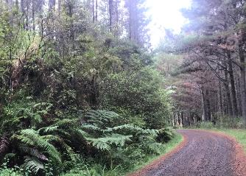
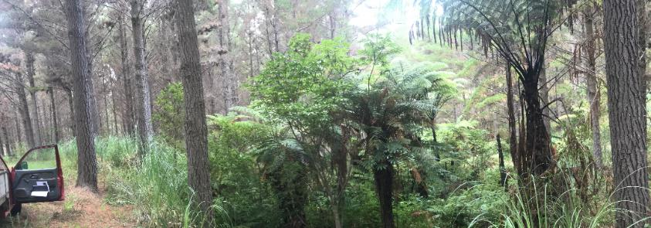
Typical places to look for remnants
Road cuttings
Headwater basins/ erosion scarps
Riparian areas
Generally high visibility areas and vulnerable to ‘inadvertent’ damage during harvesting
Notes:
Here are Typical places to find remnants
* Cuttings – especially on cut & fill sites where there is no topsoil (moisture holding capability) – also erosion scarps
* ‘head of small gullies with springs/seepages and slumps. They will now be dry , but with removal of the pines, wetlands can re-establish – especially on Ultic Soils (mottled silts and clays, poor lateral drainage, shallow rooting)
Riparian areas/wetlands which are now dry, but were wetter soils where the young trees didn’t establish, or were slow-growing.
These areas are also vulnerable to damage when roads are upgraded for harvesting – so need to be specifically protected before road construction and during harvest or they’re likely to be damaged. I’ll show some specific techniques later

Slide 7
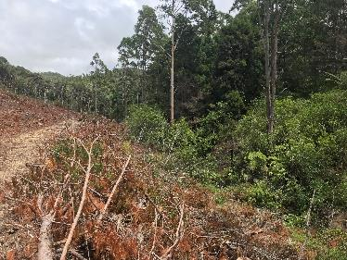
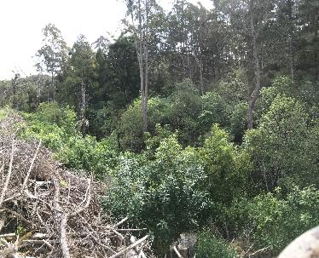
Where native regeneration occurs
Within 3 to 10 m of the ‘outside row of pine trees where largely untrafficked/squashed. This allows rapid regeneration of native plants that tolerate sudden exposure
Mature radiata on ‘outside’ rows have 7-10 m lateral branches. These stunt totara, kanuka (gorse and broom) but not shade-tolerant natives (ferns, rimu, young beech)
Residual native shrubs/ferns compete best against weeds when they get a ‘head start’ and are protected by windrows and/or light ‘slash’
Notes:
Photo: This is my property in Northland near Whangarei – the top photo is just after harvest, and the bottom photo about eighteen months post-harvest.
Typical native remnants are narrow, and along streams. Here, harvesting has minimised machine access and damage within 5 to 10 m of native remnants and riparian area, leaving the surface relatively intact. Pine branches were put as a narrow windrow along the road edge with a few gaps for access. The windrow and slash form shelter that help retain soil moisture; the windrow, which is well above the floodplain also helps stop sediment movement (erosion control) and makes it harder for hares to get small native trees (we don’t have goat or deer so close to hunters!) but we do have pigs
Note: if this was gong back into pine, from a foresters point of view, they would consider that the outside pine trees develop bigger branching (diameter of the branch at the stem) which leads to down grading of log grade, so less income. To get over this, they may high prune the outer edge (my preferred option) or plant both sides of the road, right up on the old stump line – but this would reduce the protective riparian buffer and supress the best native regneration

Slide 8
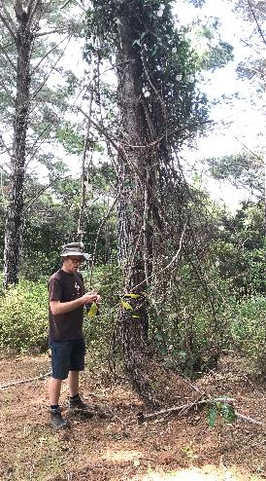
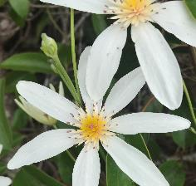
Five principles for ‘no regrets harvesting’ that boosts native biodiversity
Principle 1. Build on what’s there – buffer and bulk up native remnants; look beyond seed sources
Principle 2. Not every pine tree or area is worth harvesting
Principle 3. Focus on easy wins. Road footprint, avoidable damage; avoidable weed spread (pre-harvest and at harvest)
Principle 4. Use wood waste wisely – it’s ecosystem magic. Plan for its retention and best-placement
Principle 5. Stack benefits. Natives can deliver multiple benefits – what do you want? Shelter, birds, green fire breaks? What do potential co-funders value: riparian for water quality and wetlands?
Notes:
Photo - Native Clematis paniculata growing up a pine tree which has been tagged not fell as at edge so relatively stable/open.
We don’t have much Clematis on our property, and it’s notoriously hard to establish, so we decided to forgo income from the pine and will poison the pine in a few years time – alternatively (and probably better) we could have asked the harvester to remove the top of the pine tree (we may still do that!)

Slide 9
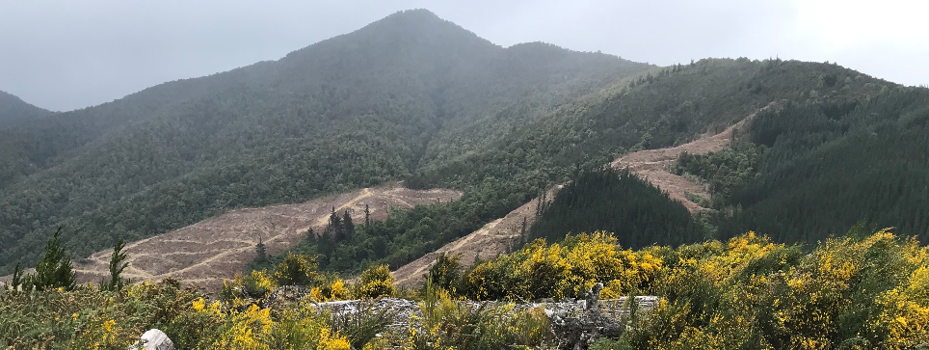
Principle 1
Build on what’s there – save native seed sources, bulk up / buffer native remnants
Notes:
Remnant beech forest in gullies from core conservation areas with pines being felled, Blenheim

Slide 10
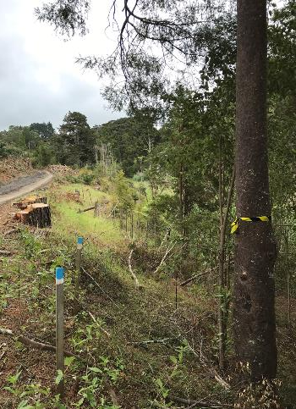
Principle 1
Build on native remnants
shift roads away from remnants*
define road cuts*
designate road side-casts / fills*
define stream crossings with water tables to prevent sediment
mark trees to be retained
mark native areas (drip zone)*
leave temporary ‘pine’ protection row and use expert to fell without time pressure*
use Bollards on road curves to prevent log sweep and scour*
use forwarder in ground-based harvesting, and haulers that reduce dragging/smearing
Notes:
‘How?
Select Location and construction methods of roads
Tweak Skid site locations, size and construction method – and number
Select logging equipment – haulers usually create less damage (especially compaction), and the damage is in places where natives aren’t (i.e. ridges/spurs, not in gullies unless logs are dragged through and not suspended). If using Ground-based harvesting, use forwarders to avoid dragging long logs with skidders that end up sweeping corners
Delimbing within the cutover (spreading slash) not Whole tree harvest. But make sure slash is not in any flood zones (windrow this) Where the slash is deeper, It may increase your planting costs as slash makes it harder to plant/scramble through.
The photo is back at our felled plantation showing a slope running down to a small stream – the matai was marked with hazard tape and then pegs put outside the drip line. The road was widened by increasing the cut, not by fill over the roots, which may have killed this super-seeding tree.
We also had great success using the occasional eucalyptus and pine as ‘ bollards’. These were rammed into the inside of road curves and by key native trees to physically stop logs being swept or dragged across remnants or areas vulnerable to unnecessary erosion … forwarders were also enormously useful to stop damage from dragged logs

Slide 11
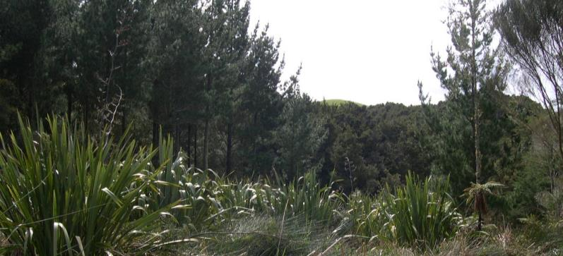
Principle 2
Not every pine tree is worth harvesting; some have more value standing live (in interim), or standing dead (poisoned):
as buffers and soil stabilisers (steep slopes, near water, Separation Point granites, NES-PF ‘red erosion zones’)
low-disturbance corridors (bats, small insectivores)
as habitat (snags, epiphytes, native understorey), karst
Notes:
Small plantings of pines were done in old catchment board days throughout NZ to quickly control erosion (also through farmland retirement/conversion incentives). They were not planted with harvesting in mind; some are not profitable to harvest, especially those that are smaller, a long way from markets oand those that require expensive access road/skid site infrastructure upgrades to access. Some forests or parts of forests are now recognised as too risky to harvest, either due to erosion risk (‘red zones’ in NES Plantation Forestry) or health and safety concerns. These forests were not generally planted with riparian buffers, unlike later forests, where riparian zones were required by Councils to help protect waterways (especially from slash and temperature shock when plantations are harvested).
Some pines support threatened native species (e.g. bats, Powelliphanta snails, kaka nests, kiwi); especially in trees with holes, cavities in areas where all the other large trees were felled years ago; and pines can act as corridors through landscapes for animals that need forests (lizards, small native birds).
Small blocks may cost land owner post-harvest for reinstatement of farm races, water supplies and infrastructure damaged by the harvesting
Steep, erosion prone slopes – difficult to access and where pines are low quality, where damage will exceed value retrieved… )
Where health an safety risk of harvesting is high (steep slopes, drops)
Cost of harvesting is high (slow, strops needed)

Slide 12
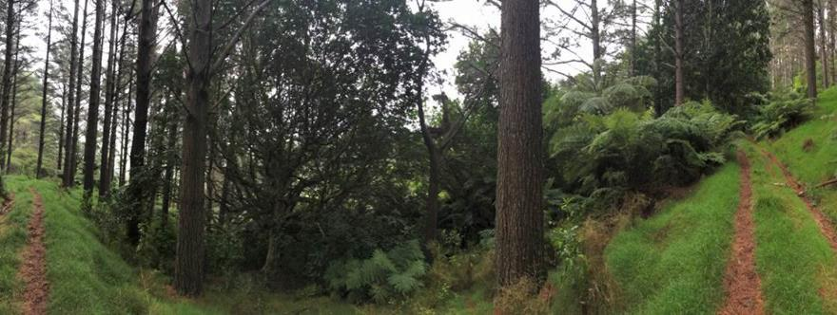
Principle 3
Focus on easy wins. Weeds are soul destroying; prevent new weeds entering on logging equipment, stop spread of existing weeds (espec. road construction), use weed prevention strategies (over-sowing, pre-emptive removal)
Notes:
unfortunately most roading tries to concentrate on the ridges and spurs as its far more stable. I guess most regen is in the gully systems.
The council will get shitty over logs left in a waterway… I use to encourage heads being left in gully systems or waterways of unconsolidated sedimentary country. Great for sediment catching…
I like the point of the forwarder… don’t you think there are a lot of ground based operations that should be cable logged…. Also the delimbing in the cutover. Less birds nests but a bastard to plant through.

Slide 13
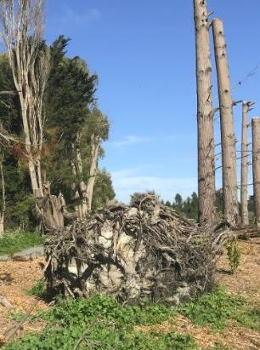
Principle 4
Use wood waste to help native regeneration (and falcons?)
Delimb across the site to leave slash that protects soil
If residual wood volumes impede access, use narrow, taller windrows (away from flood zones) = great value for insectivore birds
Leave tall stumps standing
In dry areas, push stumps over to create protected micro-sites
Use to physically protect palatable plants (fivefinger, largeleaf coprosma)
Notes:
‘

Slide 14
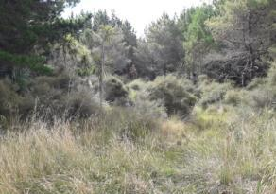
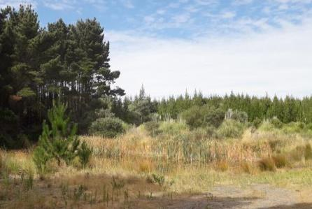
Principle 5
Stack benefits for land owner and Councils/co-funders.
Fire breaks, fire-fighting ponds, aesthetics, shelter
Seek ways to trigger, or bring in, council co-funding (e.g., riparian, wetlands, buffering or reconnecting adjacent remnants; grey scrub or forest)
Identify one-off opportunities to ‘clip on’ or ‘piggy-back’ biodiversity benefits
Notes:
Left photo –
High priority for regional council co-funding.. a patch in a pine-dune plantation with high watertable where pines didn’t establish .. This is a high priority for protection and buffering as wetland should expand as water table rises with removal of pine canopy (and sedges/rushes often regenerate really well and have long-lived seed bank), it s one of a patchwork of sites to connect reserves
Piggy-back biodiversity onto a fire fighting pond. While excavators are on site the slopes on at least three sides could be battered back to gradual edges that will better support and buffer wetland species (and safety). Another dune areas with no connection to riparian areas.

Slide 15
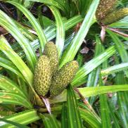
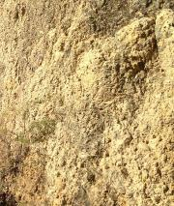
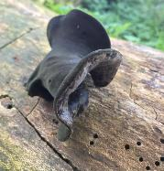
Five-steps for forest conversion
No regrets. Identify and retain residual biodiversity. Protect it to avoid inadvertent harm.
Predict natural regeneration (weeds & native). Native regeneration retains local genetics.
Rebuild and reconnect spatially, temporally (year-round food). Break pest connections.
Stack benefits and minimise total costs
Explain your vision with roading and forest harvesting contractor (and sprayer), and incentivise. Don’t entrench the minimum
Notes:
Protection – no regrets.. Areas beyond native woody vegetation which FEP are usually good at identifying
They miss: wetland herbaceous plants – so retain unploughed or undrained areas, espec if wet
They miss: bee banks; vines and epiphytes on trees (take 50-100 years to re-establish and often forgotten) The miss: areas in non-native plants – dead wood, undisturbed untrampled leaf litter layers .. Super important often in plantations
Natural regeneration: predict what will happen – find the weed seed sources and knock them out- retain legibility (and local genetics) in planting by not planting native species that will seed in (e.g., karamu coprosma robusta)
At least some biodiversity can be promoted as delivering values to areas and services outside the (fenced) remnant area or targeted biodiversity area, and/or at no additional cost (e.g. using native fruit/nectar producing trees for shelter or leaving logs alone).
References
* Conserving and Restoring Biodiversity in New Zealand urban and Rural landscapes. 2008. Manaaki Whenua Landcare Research (will need to reprint, not now available online)
* Norton DA, But J and Bergin DO 2018. Upscaling restoration of native biodiversity: a New Zealand perspective. Ecological Restoration and Management
http://www.biologicalheritage.nz/__data/assets/pdf_file/0011/165656/Upscaling_restoration_of_native_biodiversity.pdf

Slide 16
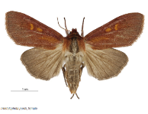
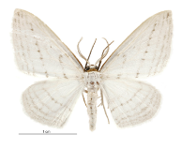


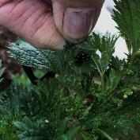
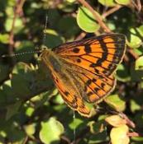
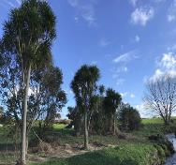
Step1. No regrets. Identify and retain what’s left.
Key vulnerabilities
crossings & old eels (don’t allow commercial eeling)
wet soils; highly compactable soils
insects of dead wood, fungi, forest floors
areas that have never been never ploughed
insects needing just one or few plants to breed
perching and climbing native plants
Intensify land that is already cleared not new areas (place sheds, ponds, tracks, lighting in cleared areas)
Notes:
Photos From left to right:
kiekie epiphyte with fruit (weaving resource, food)
fungi are rich insect supporters, with insect holes in wood; Fungi that grow on wood are a rich source of food for many invertebrates. Once invertebrates, fungi and bacteria have degraded wood to a degree that fruiting bodies of fungi start to sprout and the wood crumbles easily it has reached a stage of rotten or decayed wood. As the wood breaks down even further it accumulates as wood mould or humus.
Decayed wood and wood mould can be utilised by a wide range of invertebrates including many fungus feeders, predators and parasitoids.
non-native nettles with admiral butterfly larvae in silken hide that help hide from predators such as birds and wasps. http://nzbutterfly.info/downloads/nzButterfly.info-factsheet-red-admiral.pdf
copper butterfly whose caterpillars only feed on meuhlenbeckia vines;
cabbage trees and two moths: top – the astelia wainscot whose caterpillars only on tank lillies – astelia) and cabbage tree butterfly (one of three species of moth that only feed on cabbage tree, ti kouka)

Slide 17
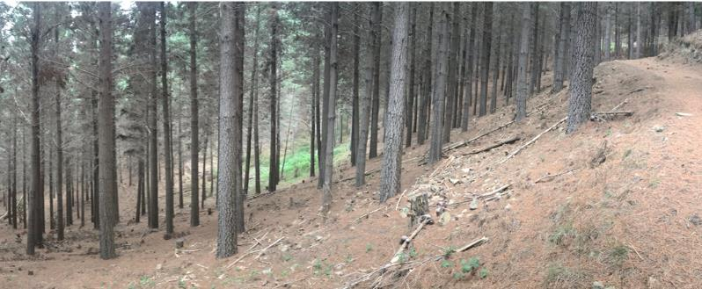
Step 2. Predict natural regeneration.
Help fix what’s limiting it.
Look for native and weed seedlings under native and non-native canopy. Look at steep, areas/outcrops, wet areas, tallest trees. Find weed sources.
Common issues: Stock/deer browse, Weed competition / smothering, Compaction / erosion (no soft humus), Lack of suitable logs, Lack of native seed source (200-500 m)
Notes:
Here – Blenheim/Malborough typical north facing slope. Dry, tall and dense pine trees with little light and lots of moisture stress so no understorey, including weeds.
BUT – blackberry in wetter areas, grey scrub on outcrops,
Note
If want birds then must also have mammal control; wetland birds with dog exclusion and low disturbance (espec wary birds – check locations of races)
If farmers want butterflies usually also need wasp control

Slide 18
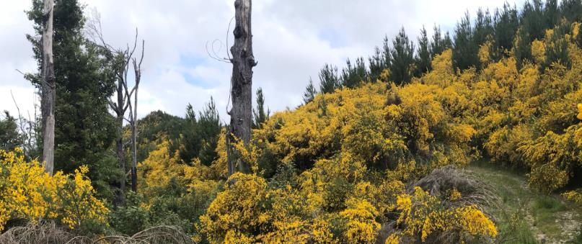
2. Predict weed regeneration
Where regrowth of gorse, broom, tobocco weed will be dense; consider broadcasting a cover crop (legume or grass) soon after harvest to fill the space in areas where native regeneration is low (it also helps with erosion control)
Pre-emptive strike the sparse weeds and all ginger, tradescantia, blackberry, honeysuckle while access is easy – work from population edges, remove seed bank when road-working (don’t spread it)
Notes:
Broom on Blenheim hills with native remnant on the down-hill side of the road. A great distance between natives and the pines, but it will be filled with broom for a decade or two.
Bioscurity is important and often poorly managed, but enormously cost effective for the land-ower, especially for plants that are spread in long-lived seed along roads
Bulbs (montbretia, aristea, freesia) are spread along roads
Spanish heath will wind-blow from one to many cuttings
The plants to focus on controlling prior – are ones that are hard to control after havesting because they hide and scramble under the fallen slash, so can build up over the 3-5 years for the slash to break down. If you have Asiatic knotweed – I’d put it in that category too
Include problematic tree weed such as Sycamore, rowan, cherry

Slide 19
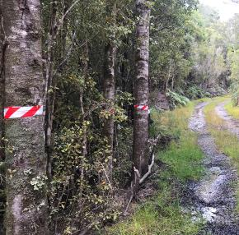
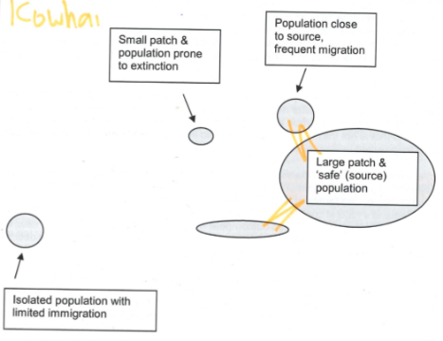
3. Rebuild and Reconnect across landscape
Conserve margins – expand range – expand diversity
Expand year-round food requirements of target birds
Provide secure breeding places by adding pest control (accessible, regularly visited as part of ‘other’ work)
Notes:
Rebuild and reconnect spatially, temporally (year-round food). Break pest connections

Slide 20
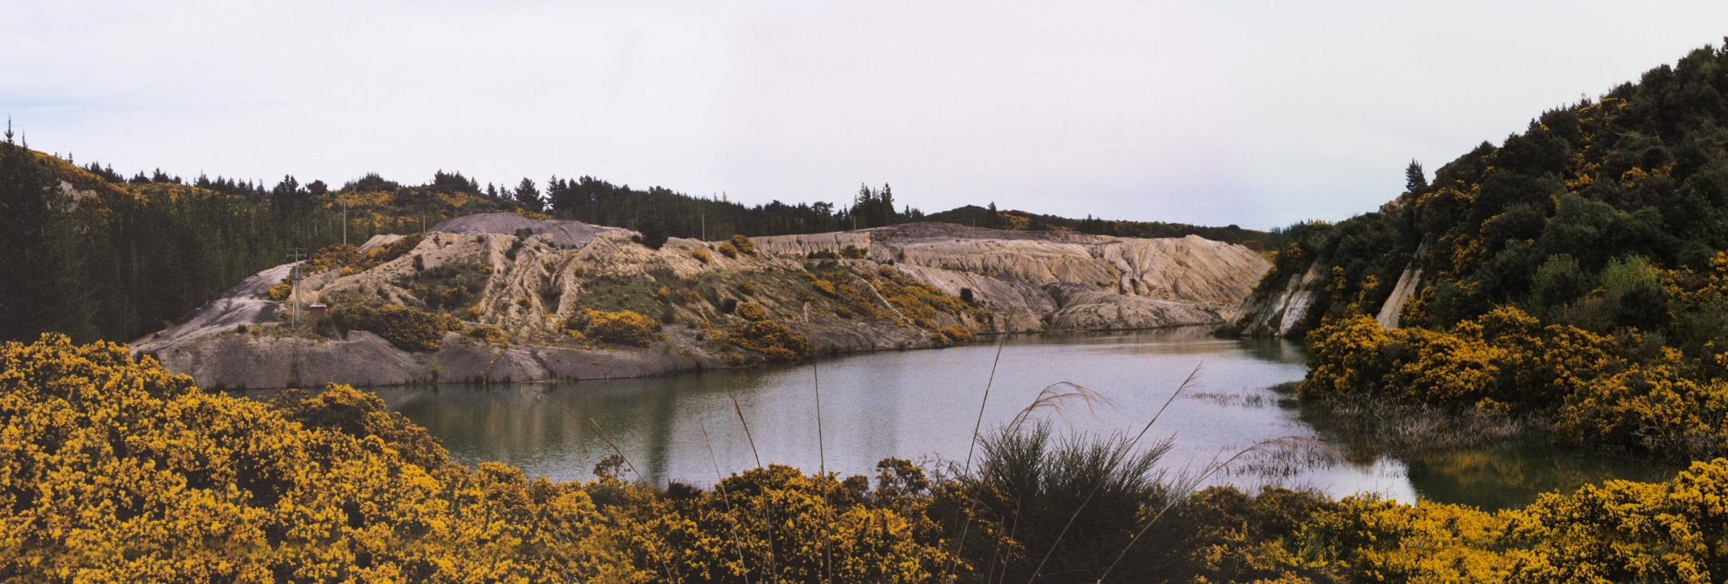
4. Stack benefits and consider total cost
Consider costs and risks of active planting & native regeneration (what approach suits which areas)
Not every pine tree/stand is worth harvesting – it may be better to poison standing

Slide 21
5. Don’t entrench the minimum
Explain your vision to harvest planner, roading and forest harvesting contractor, spray contractor
Reinforce your vision with physical marking on maps and on the ground (posts, spray paint, bollards, crossings) – prioritising to provide contractors some leeway to develop better solutions
Reinforce your vision with incentives, and disincentives
Give early feedback during harvest
Notes:
A harvest planner is generally trained to maximise yield, not optimal economic and ecological outcomes. They (and we) often think of harvesting and native regeneration as two independent exercises, when they are inextricably linked.
We need to help ensure the cost of planting and weed control post harvest is considered, alongside the benefits of regeneration. Shapes of blocks have a big influence on what is economic to leave or fell, as does the cost of access. Pine Blocks that are uneconomical to harvest often need to be treated (poisoned) – or they eventually fall over causing secondary erosion. Most sites will have potential for natural regeneration in parts of sites; and most will require some planting. There is no one solution or recipe..
All the best! Please don’t be tidy - is hard to leave slash across an area

Slide 22
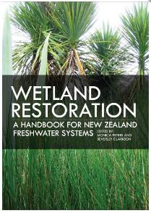
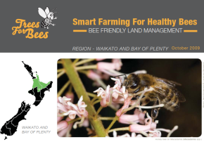
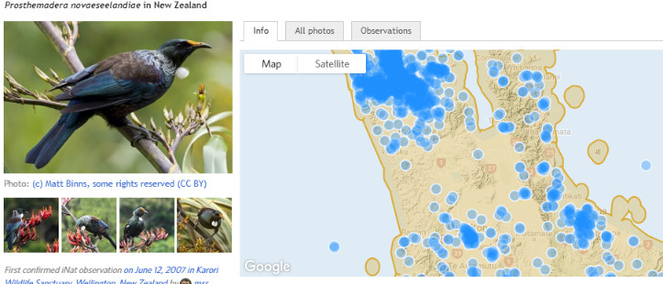
Some resources
(add Nelson restoration guide – its great)
i-naturalist new Zealand https://inaturalist.nz/
NZ Plant Conservation Network http://www.nzpcn.org.nz/
NIWA Guides to restoring freshwater native fish habitat, & inanga habitat
https://www.landcareresearch.co.nz/publications/books/wetlands-handbook
http://www.weedbusters.org.nz/ and https://qeiinationaltrust.org.nz/wp-content/uploads/2018/02/Weedbusting-tips-a-Compilation-OS-weebusters-articles-FINAL-web.pdf
http://ourbigbackyard.nz/plant/
Protected Natural Areas Programme reports (DOC + RCs 51 published?+17)
Notes:
* PNAP review: http://docs.niwa.co.nz/library/public/PNAP.pdf Figure is from 2004 report by Wildlands .. Need to update to check
* Norton DA, But J and Bergin DO 2018. Upscaling restoration of native biodiversity: a New Zealand perspective. Ecological Restoration and Management
http://www.biologicalheritage.nz/__data/assets/pdf_file/0011/165656/Upscaling_restoration_of_native_biodiversity.pdf
Pawson et al 2010. New Zealand’s exotic plantation forests as habitats for threatened indigenous species. New Zealand Journal of Ecology: 34(3):342-355
https://www.landcareresearch.co.nz/publications/researchpubs/LRSS35_nature_neighbourhoods.pdf
https://www.niwa.co.nz/our-science/freshwater/tools/guide-to-restoring-freshwater-native-fish/tools/restoring-physical-habitat) and
Taylor J and Richardson MJ 2004 NIWA Science and Technology Series No.50. MJ https://www.niwa.co.nz/sites/niwa.co.nz/files/a_guide_to_restoring_inanga_habitat.pdf
‘Landscape and Ecological values within Stormwater management

