Slide 1
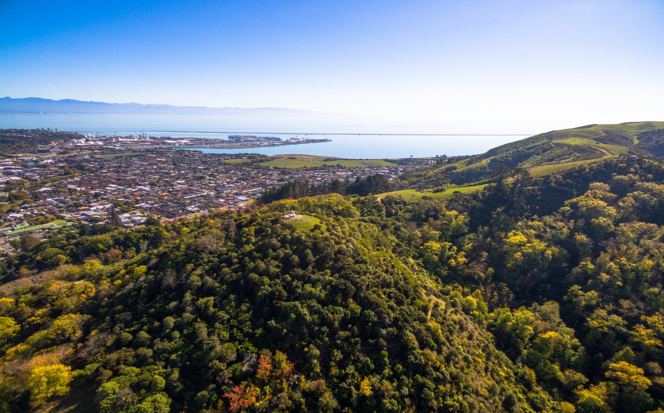
2019 Candidate Information Evening Nelson City Council

Slide 2
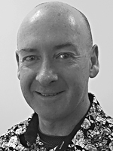
2019 Candidate Information Evening Nelson City Council
Warwick Lampp
Chief Electoral Officer – electionz.com
Nelson City Council Electoral Officer
Pat Dougherty
Chief Executive Nelson City Council

Slide 3
2019 Candidate Information Evening
1. Introduction to Nelson City Council
Pat Dougherty - Chief Executive
2. Election Details 2019
Warwick Lampp - NCC Electoral Officer
3. The Nomination Process
Warwick Lampp - NCC Electoral Officer

Slide 4
2019 Candidate Information Evening
4. Campaigning
Warwick Lampp - NCC Electoral Officer
5. Process and Results
Warwick Lampp - NCC Electoral Officer
6. Life as an elected member
Paul Matheson - Deputy Mayor
Stuart Walker - Councillor

Slide 5
Part 1: Introduction to Nelson City Council

Slide 6
What is Local Government all about?
It’s a complex business!
Under more than 125 pieces of legislation, Council is responsible for:
Formulating the city’s strategic direction in conjunction with the community through the Long Term Plan (LTP) and reporting on progress
Determining the services and activities to be undertaken by the Council
Managing various regulations and upholding the law, including the formulation and enforcement of bylaws
Advocating on behalf of the local community with central government, other local authorities and other agencies
Environmental management through the Nelson Resource Management Plan
Ensuring local communities are encouraged to be part of the decision-making processes of local government
Ensuring effective succession of Elected Members

Slide 7
Job description
Represent interests of Council
Formulate strategic direction and priorities
Determine expenditure and funding
Monitor performance
Develop and oversee policy
Ensure prudent use of council resources
Employ and monitor the CE only

Slide 8
Core competencies
Genuine interest for issues faced by Nelson community
Relate to wide range of people – strong people skills
Competent listening and public speaking skills
Express ideas clearly and be results focussed
Understand, analyse and resolve complex issues
Understand governance versus management
Think “city-wide” on issues
Commit to elected members’ Code of Conduct

Slide 9
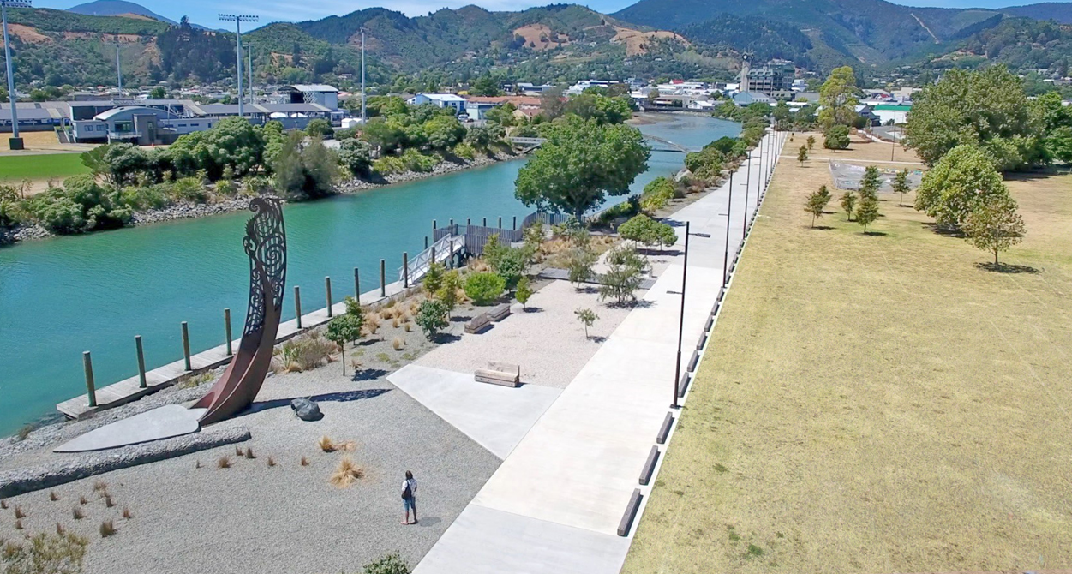
Nelson City is a Unitary Authority
Territorial Authority
Regional Council

Slide 10
Council Activities
Transport
Water supply
Wastewater
Stormwater
Flood protection
Solid Waste
Environment
Social
Parks and active recreation
Economic
Corporate

Slide 11
Council meetings and Remuneration
Council and Committee meetings generally held on Thursdays every week. Plus Tuesdays and Wednesdays when workload peaks.
Generally they start at 9am and go for 4-6 hours
90 Council and Committee Meetings for 2018
Generally Mayor is full time job, Councillor is approx 30 hrs/week
Lots of reading of reports and agendas
Flexible working hours – evening and weekend work required
Remuneration:
Mayor $ 144,500 pa
Councillor $ 39,686 pa minimum base
Paid fortnightly

Slide 12
Vision
Priorities:
CBD Development
Environment
Infrastructure
Lift Council Performance

Slide 13
Key Policy Documents
Long Term Plan (LTP): Under the Local Government Act 2002, we are required to detail the activities we undertake and the outcomes desired for a period of at least 10 years
Annual Plan: This defines Council’s work programme for each financial year

Slide 14
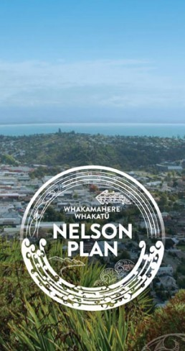
Key Policy Documents cont…
Annual Report: This reports to ratepayers on Council’s performance in relation to what it said it would do in its Annual Plan
Whakamahere Whakatu Nelson Plan: will incorporate the Regional Policy Statement, Air Quality Plan, District Plan, Regional Plan and Regional Coastal Plan into our document.

Slide 15
Three Yearly Planning Cycle
30 June 2018
30 June 2019
30 June 2020
30 June 2021
30 June 2022
LTP 2018-2028
LTP 2021-2031
Annual Plan
Year 1
Annual Plan
Year 2
Annual Plan
Year 3
Annual Plan
Year 1
Annual Plan
Year 2

Slide 16
The Organisation
Council employs the Chief Executive
The Chief Executive employs all staff
Primary role of staff is to implement the decisions of Council, and provide the service to Council and the ratepayer

Slide 17
Part 2: 2019 Election Details

Slide 18
Electoral Team
electionz.com Ltd contracted by Nelson City Council
Warwick Lampp - NCC Electoral Officer
Mary Birch - NCC Deputy Electoral Officer
Robyn Byrne - NCC Electoral Official

Slide 19
Who are electionz.com?
Warwick Lampp, electionz.com, lives in Tauranga
Election services company based in Christchurch
10 full time staff
Average about 200 elections in NZ each year
EO for 33 councils, 4 RCs and 10 DHBs
Carrying out vote processing for 42 councils, 650K voting papers
Vote Processing centre in Christchurch
EO for:
BOPRC, GWRC, ECAN, ORC and ten DHBs (incl NMDHB)
Tauranga, Rotorua, Taupō, Waipa, Otorohanga, Waitomo, South Waikato, Ruapehu, Rangitikei, Manawatu, Palmerston North, Horowhenua, Napier, Central Hawkes Bay, Carterton, Wellington, Masterton, South Wairarapa, Upper Hutt, Nelson, Westland, Kaikoura, Hurunui, Waimakariri, Selwyn, Ashburton, Mackenzie, Waimate, Waitaki, Dunedin, Central Otago, Gore, Invercargill

Slide 20
Electoral Officer Role and Responsibilities
The Electoral Officer (EO) is solely responsible for the conduct of the election
The EO is not subject to the directions of any local authority, elected members, or the CE
Provides a level playing field for all candidates
NB Not responsible for monitoring campaigning by candidates. Only deals with alleged breaches of the Act by passing them to the Police.

Slide 21
Key Dates
Election Period starts 12 July (Friday)
Nominations open 19 July (Friday)
Electoral signs can go up 12 August (Monday – 2 months prior)
(Bishopdale Hill and Miyazu Park special areas) 12 September (Thursday - 1 month prior)
Nominations close 12 noon, 16 August (Friday)
Delivery of voting papers 20 – 25 September (Friday-Wednesday)
Special voting period 20 September - 12 October
Removal of election signs 11 October (Friday)
Close of voting 12 noon, 12 October (Saturday)
Progress results available 12 October, approx 2pm
Official declaration likely to be 17 October (Thursday)
Candidate expenses deadline probably 12 December (Thursday)

Slide 22
Part 3: The Nomination Process

Slide 23
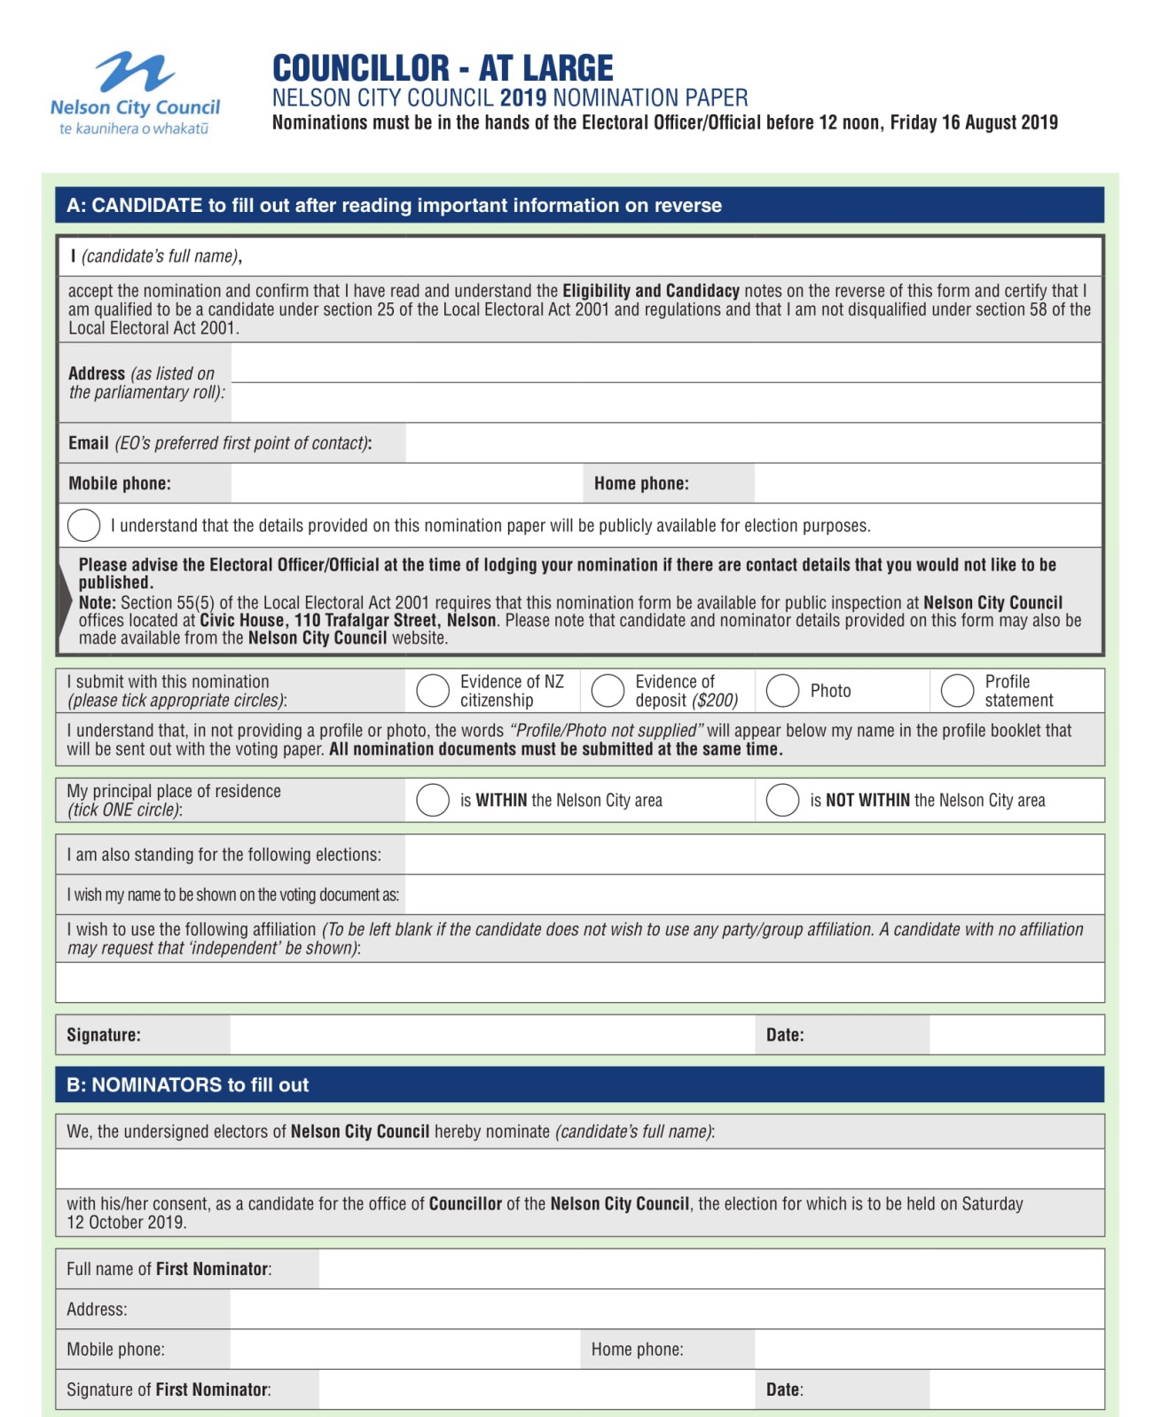
PART THREE
The Nomination Process

Slide 24
Nominations will be called for:
Mayor
Councillors At Large 12 councillors
Nelson Marlborough DHB 7 members at large (STV)
All candidate names are in random order

Slide 25
Nomination Process
Nomination Period – 4 weeks
Nominations open Friday 19 July
Nominations close at midday Friday 16 August
All nomination documents must be submitted together
Nom paper, profile statement, photo, evidence of $200 deposit
Must provide evidence of NZ Citizenship (passport, birth cert)
Must come to the NCC office if in person, or scan and email to the DEO (elections@ncc.govt.nz)
Cannot put nom paper in first week, leave profile till last week
Will accept online banking of deposits – evidence required
Cheques will not be accepted
Nomination paper includes warning for candidates to be aware that contact details will be public info
Can use commonly used name on voting papers – but no titles
Party affiliations – cannot be offensive, confusing, or too long

Slide 26
Nomination Process (continued)
Candidate must state if standing in any other elections in NZ
Mayor, Ward/At Large Council, Comm Bd, LTs, DHB, other TAs?
Is shown at top of profile statement
Is not included in the 150 words
Applies to standing anywhere in NZ
Must update earlier nomination form if not included
Nomination paper is a public document, open for inspection
Candidate must state if reside in area of election or not
My principal place of residence is WITHIN / is NOT WITHIN the area
Is shown at the top of the profile statement
Is not included in the 150 words
Other elections
Nelson-Marlborough DHB noms to Nelson City Council

Slide 27
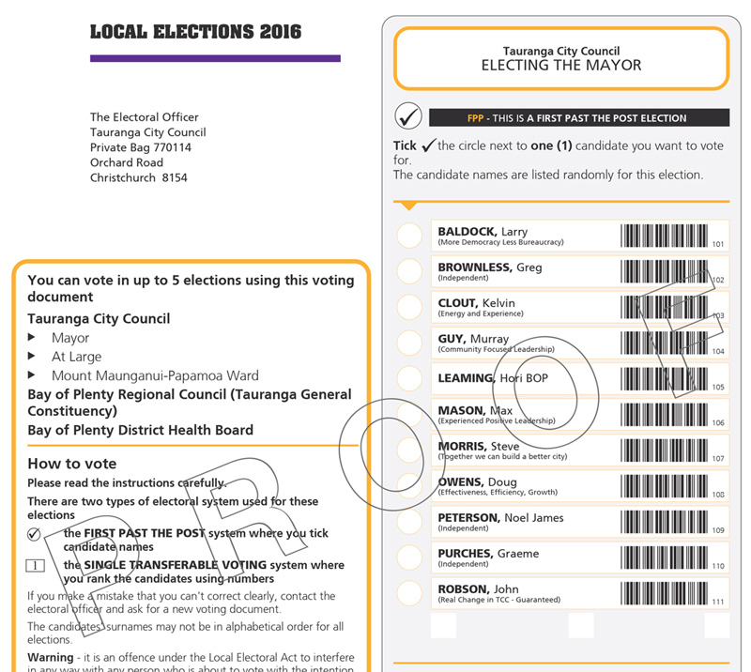
2016 Voting Paper

Slide 28
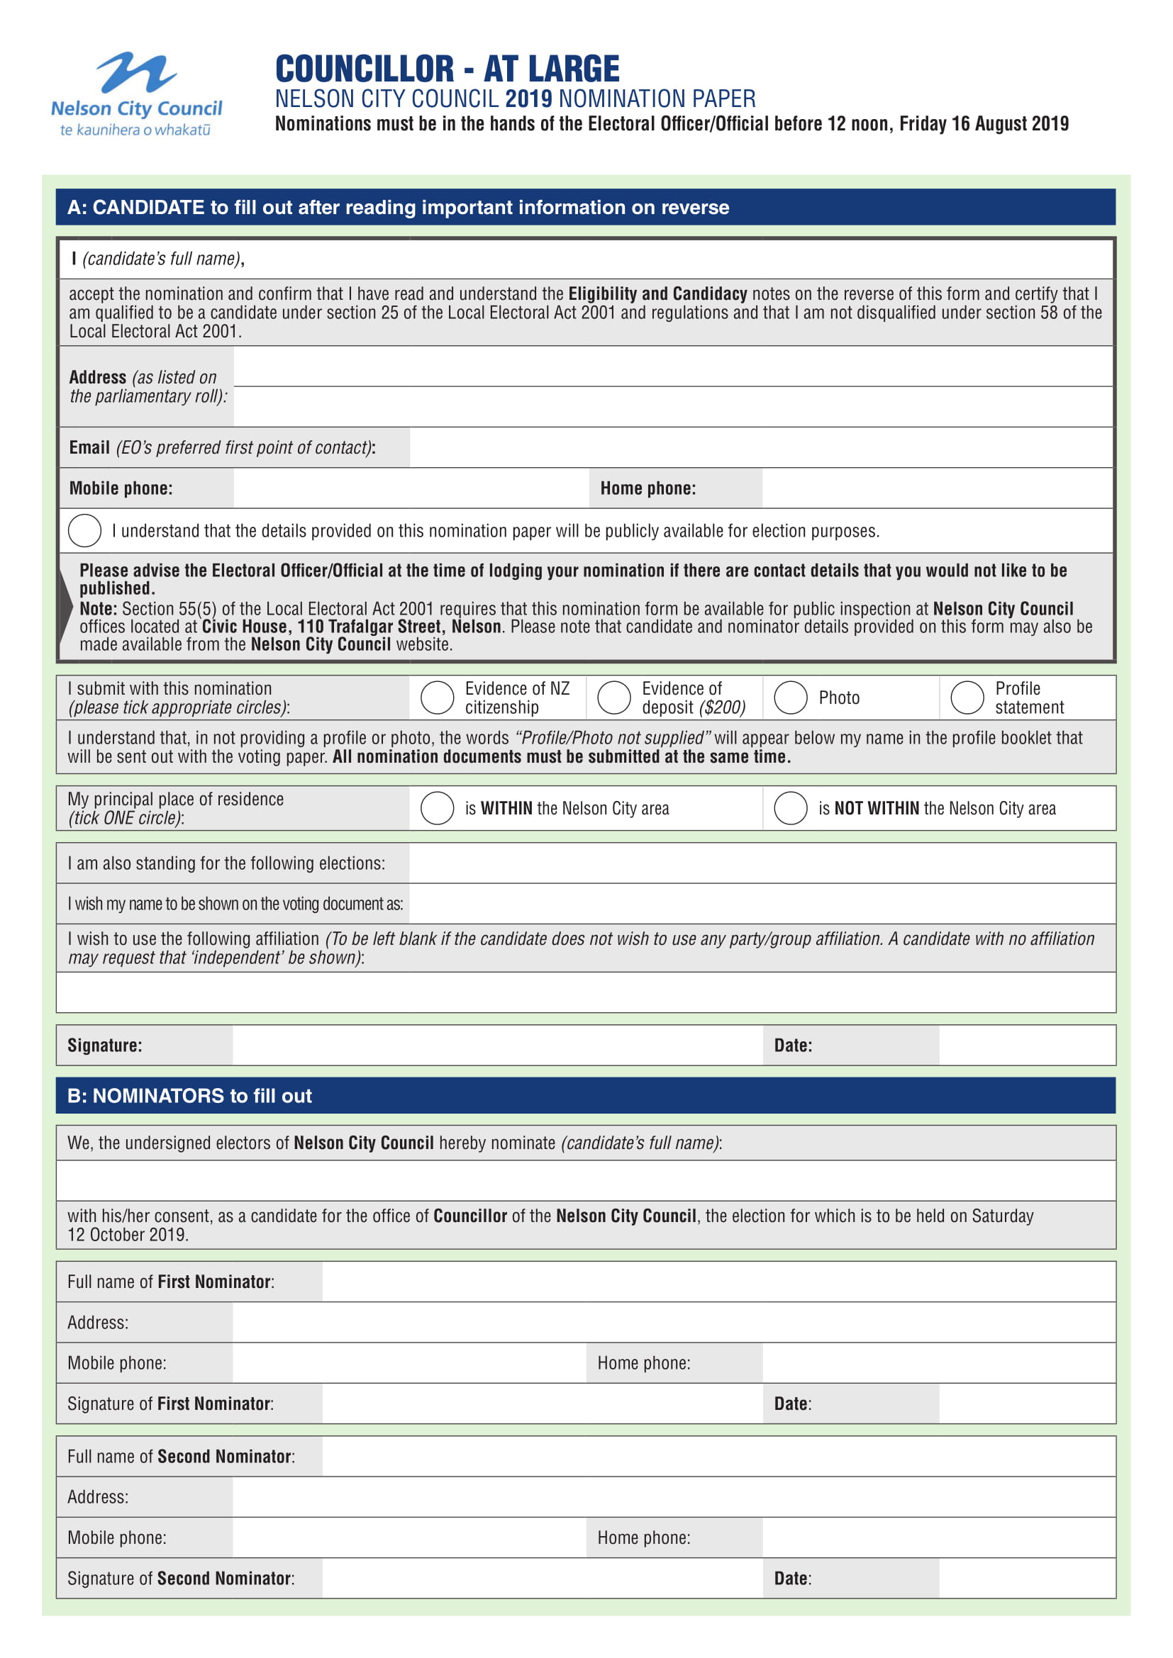
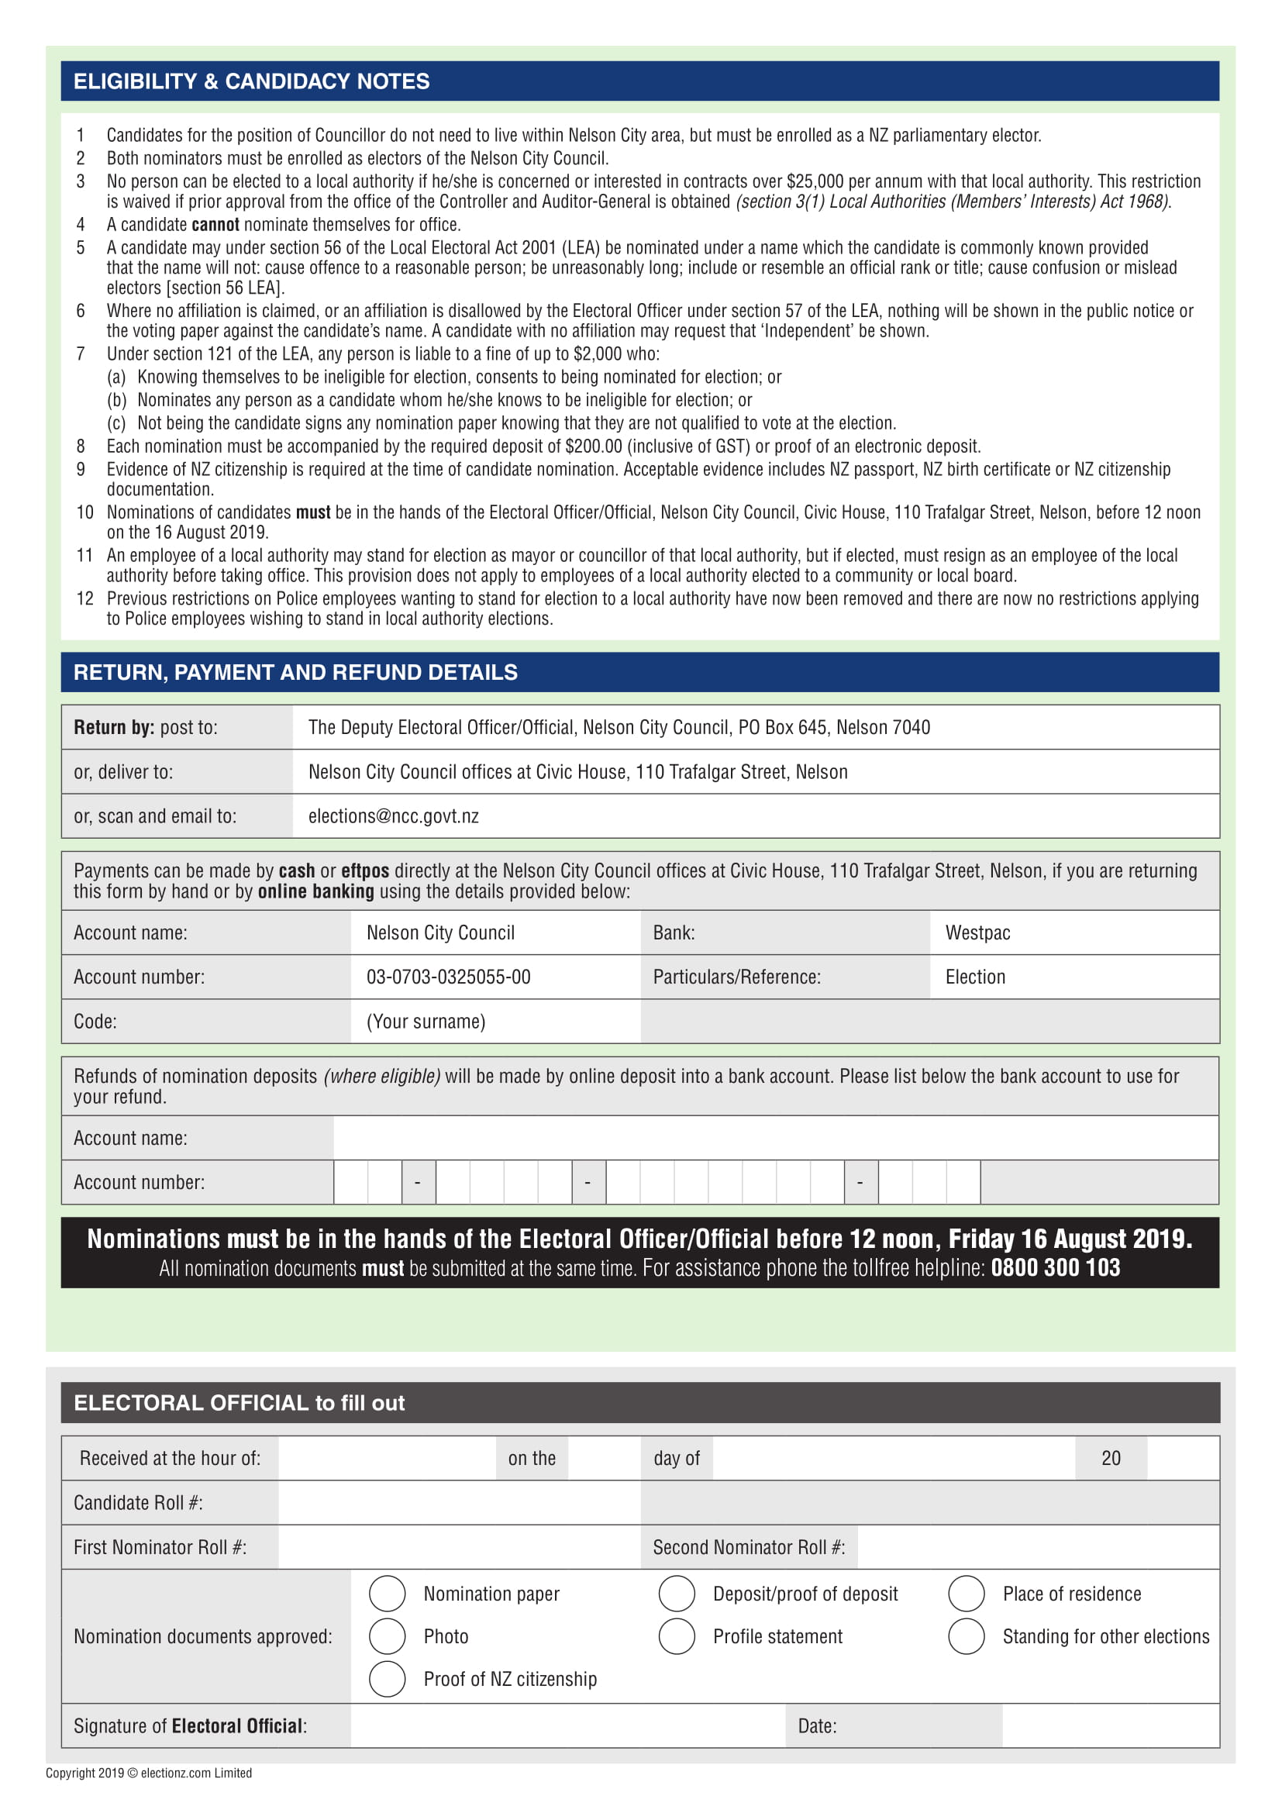

Slide 29
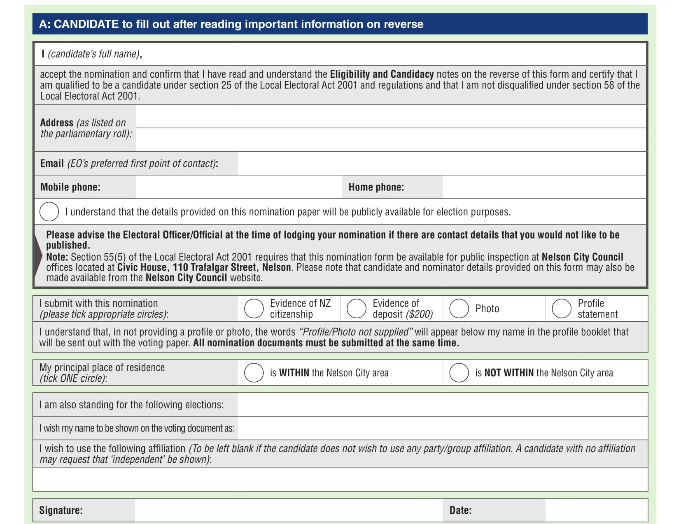

Slide 30
Candidate Qualifications
MUST BE:
A New Zealand citizen (required to provide evidence)
Enrolled on the parliamentary electoral roll (in NZ)
Nominator and seconder on the roll in the area
CANNOT:
Be serving a prison sentence of three or more years
Have interest in a contract over $25K per year with council
CAN STAND:
For DHB and the council (mayor and council)
For both mayor and councillor, or another council
If a council employee but must resign if elected as mayor or councillor

Slide 31
Candidate Withdrawals
A candidate cannot strategically or politically withdraw after nominations have closed
Same as for parliamentary elections, ie death or incapacity only
Medical certificate required – deposit refunded
Withdrawal application can be made by candidate or their agent

Slide 32
Candidate Profile Statements
May be provided (not mandatory) – see page 16
If provided, must be provided electronically with the other nomination documents, as an email attachment (MS Word) or on a pen drive
Up to 150 words about the candidate, their policies and intentions
Cannot comment on policies etc of any other candidate
Hand written profiles will not be accepted
Profiles and photos should be emailed to the DEO but hard copies must be attached to nom paper, i.e. all docs submitted together
EO not required to verify or investigate any information included in profile
Photos in colour, within last 12 months, head and shoulders shot only (no hats, sunglasses, children, pets or friends)
Photos should be supplied electronically as jpgs, scanned at 600 dpi
Profiles on NCC website as soon as ready after close of nominations
Candidate contact details on NCC website after close of nominations

Slide 33
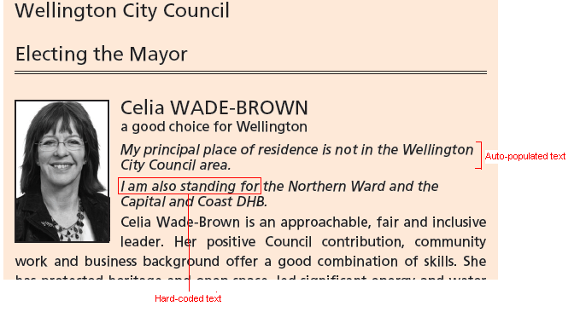
Example Profile Statement

Slide 34
Part Four: Campaigning

Slide 35
Campaigning
Can commence any time
Generally no rules around campaigning or conduct, but:
Can’t use council resources for campaigning (logo, branding, colours, NCC FB or twitter feed, photos, council buildings)
Voting papers should not be collected from electors by candidates or their assistants
Election expenses for campaigning must be recorded and declared in a return after the election
Any campaign material (signs, posters, billboards, flyers, ads, cars, social media) must have an authorisation from the candidate or their agent, stating their name, and physical address
Not a PO Box, Private Bag, rural number, website address, council’s street address
Must be on the front of the sign or promotional material (not the back)
Any content of signs is subject to ASA guidelines and complaints process – must be factual
Usual rules of defamation apply but don’t complain to the EO if you don’t like what someone says about you!

Slide 36
Social Media
Beware of Social Media! During the three month election period:
Council’s social media channels will unlike / unfollow all candidate social media channels
Candidates must not link their own social media channels (if they are used for campaigning purposes) to the Council’s social media channels, and must ensure that they have the appropriate authorisation
NCC social media channels cannot be used for electioneering by candidates or members of the public – will be constantly monitored and strictly enforced
Any post - positive or negative - made by any individual specifically relating to their own or someone else's nomination, intention to run for Council or election campaign, will be removed
Council’s social media channels will remain neutral. Council will promote elections and the importance of voting but will not associate these posts with any candidates
During the lead up to elections, the current Mayor and Councillors may be used in social media posts where it is appropriate and is considered ‘business as usual’ to use them.

Slide 37
Social Media continued
This means, when with the intention of campaigning / electioneering:
No posting on Council pages / accounts
No comments / replies on Council pages
No mentions with a tag
No picture tagging
No rating or reviewing Council pages or posts
No sharing / reposting of NCC posts with electioneering comments
e.g. you cannot electioneer on Council’s channels, or piggyback on their audiences – see page 19

Slide 38
Election signs
See page 20 of candidate handbook
Election signs can go up from Monday 12 August
(2 months prior to election day)
(Bishopdale Hill and Miyazu Park special areas) from 12 September - 1 month prior)
Maximum of 10 signs per candidate in the city
Can be on private land, but only for 2 months
Must be removed day before election day, ie Friday 11 October
NZTA rules apply for State Highways, see page 21
Vehicle signwriting is ok – cost of running a vehicle if it is own personal transport is not an election expense
The cost of framing for a sign is not an election expense
Complaints made to NCC’s Enforcement Officers – not the EO or DEO

Slide 39
Electoral Donations
No time limit on when donations are received, every donation to be recorded
You don’t have to accept a donation – be careful of reason for donation
Must be included in candidate expenditure return
No such thing as an “anonymous” donation if you know who it has come from:
someone can’t give a donation and ask for it to be treated anonymously
anonymous means you don’t know who it came from, can’t reasonably work it out
A third party who passes on a donation must disclose who the donor is
An anonymous donation cannot be over $1,500:
if it is, candidate can’t keep balance over $1,500, it must be given to EO to pass onto council
a donation made up of contributions (e.g. to a trust) is treated as one donation, and can’t be over $1,500 if anonymous
it is an offence to circumvent $1,500 limit, i.e. by deliberately splitting up a donation into smaller contributions.

Slide 40
Election Expenditure Limit
Nelson Mayoralty $30,000
Council At Large $30,000
NMDHB $55,000

Slide 41
Election Expenses
If standing for more than one position the higher limit applies
The applicable period for which campaign expenditure limits apply is 3 months before election day - 12 July 2019
Candidates required to provide details of electoral expenses incurred before or after the applicable period to Electoral Officer – pro-rata expenses for activity outside the 3 months
Electoral expenses and electoral donation returns required within 55 days after the official result declaration – about 12 December
Deposit not refunded until the return is completed (provided candidate gets more than 25% of the votes of the lowest successful candidate)
Electoral expenses and electoral donations returns are public documents
EO must make expenses documents available on council website for 7 years
See page 16 of the Handbook

Slide 42
Election Offences
See page 34
Imitation Voting Paper – examples next slide
Bribery
Treating
Can’t provide food, alcohol, drinks, entertainment as an inducement to vote (light refreshments after a meeting is ok)
Can’t give away a pen, note pad, fridge magnet or item of value
Undue Influence – cant stand over someone telling them how to vote, or post or deliver someone else's voting paper
Unauthorised advertisements
Illegal nomination – e.g. candidate with a court order
Any formal complaint passed straight to the Police

Slide 43
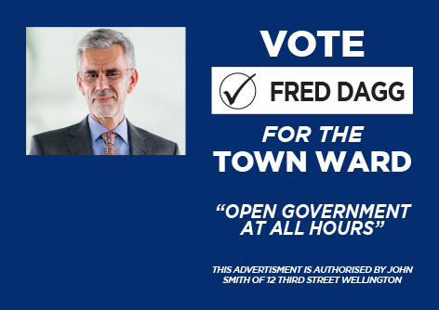
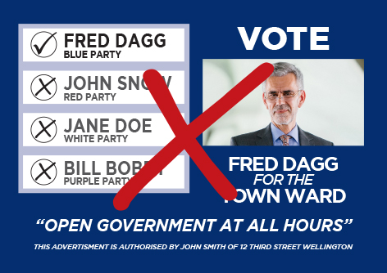
Example of Signs

Slide 44
Part 5: Election Process and Results

Slide 45
Electoral Rolls
Preliminary Electoral Roll
available for public inspection from 19 July to 5pm Friday 16 August 2019
at all libraries and the council offices
includes the ratepayer roll
Cannot be provided electronically to candidates
Final Electoral Roll
produced following the EC update campaign
is the roll used for issuing voting papers
can purchase hard copy for $100 (plus GST)

Slide 46
Special Voting
Available for anyone who spoils, loses, or does not receive their voting paper or enrols after 16 August
Available for electors on the unpublished roll
Available from 20 September to 12 noon on election day, 12 October 2019
available from the NCC office, can be posted out
Applicants can come in or contact DEO by phone or email
Candidates cannot collect special voting documents on behalf of electors

Slide 47
Election Results
Preliminary count occurs from 12 noon, Saturday 12 October 2019
Progress results expected about 2pm – approx 98% of votes received (not special votes and votes in transit to processing centre).
Progress results:
Will be available from council’s website
email to all candidates with email address
Candidates personally rung by council staff
Preliminary results expected late on Sunday 13 October, after all ordinary votes have been processed
Final results expected by Thursday 17 October, after special votes have been processed

Slide 48
Coming into Office
All members come into office on the day following the day on which the candidates are declared to be elected
This is the day after the public notice has been published - expected to be Friday 18 or Saturday 19 October
Successful candidates contacted by mayor/staff
Council’s inaugural meeting and the “swearing in” of elected members (elected candidates cannot act until this has occurred) – expected to be Thursday 31 October 2019

Slide 49
Resources
NCC candidate handbook and nomination papers
LGNZ 'Making a Stand' booklet
NCC’s Pre-election report – available from 31 July 2019:
To inform the community and candidates on key aspects of Council business
To set out major projects and expenditure for next 3 years
To promote discussion on issues and inform any elections debate
Legislation (LEA, LER)
Council's website (for election information):
NMDHB candidate handbook

Slide 50
Last word
No Online Voting
Campaigning
Election results – on websites/email – progress/prelim/final
Election day – Saturday 12 October 2019
Good luck!!

