Slide 1
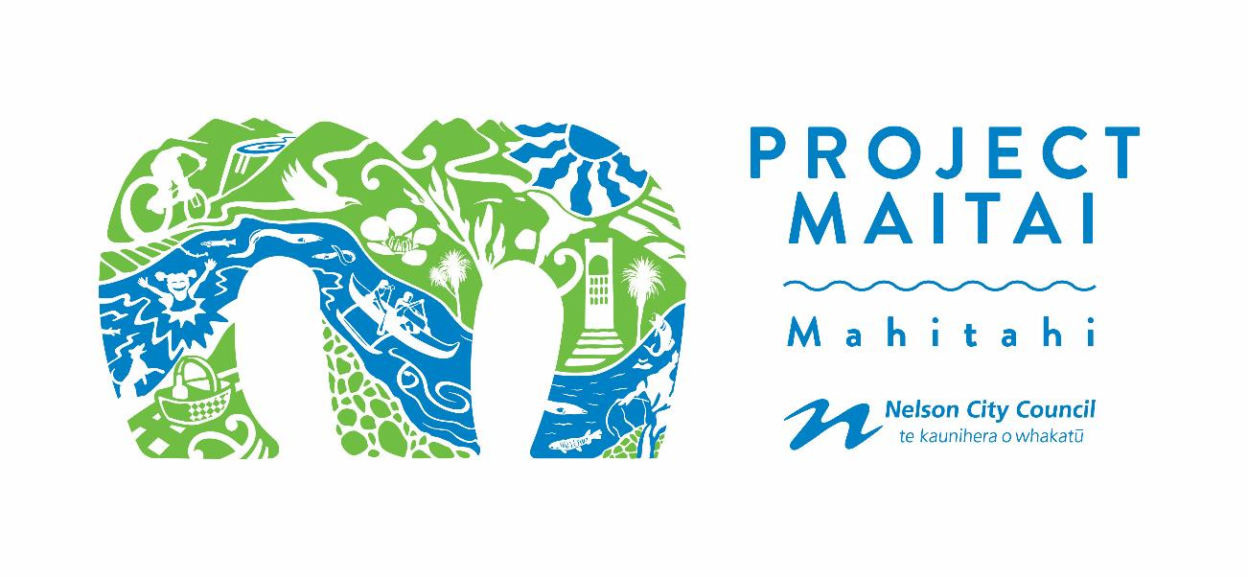
www.nelson.govt.nz/projectmaitai
www.friendsofthemaitai.org.nz
Jo.Martin@ncc.govt.nz

Slide 2
People are interested in YOUR work ☺
How can you involve them?
Stormwater engineering

Slide 3
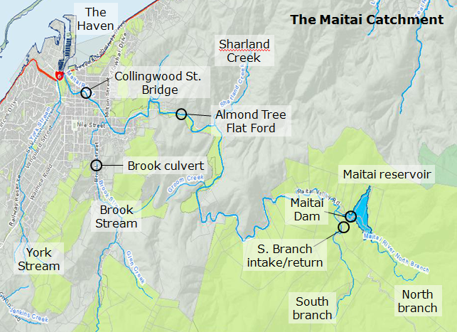
The Maitai River

Slide 4
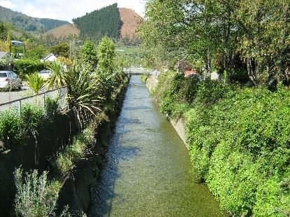
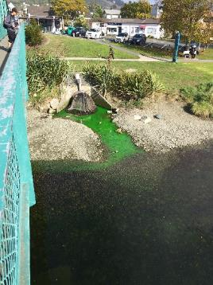
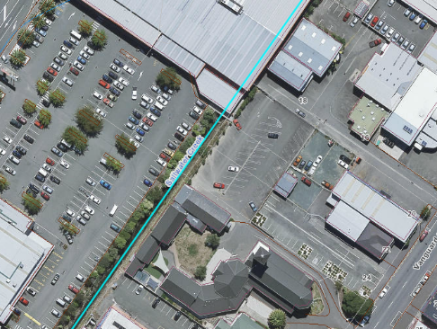
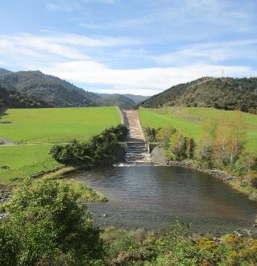
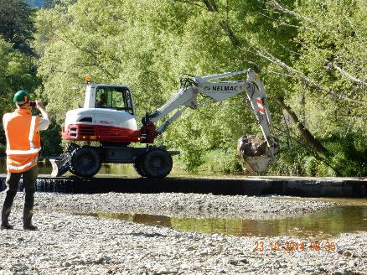
Green space vs usable land.
Flood conveyance vs natural state.
Swimmable water vs stormwater conveyance.
Drinking water supply vs natural river flows.
In-stream biodiversity vs in-stream infrastructure.

Slide 5
Community participation is essential because:
it allows diverse community values to be incorporated into stormwater and urban waterway management decisions;
in an urban setting the whole community impacts on the river in some way;
if people understand the infrastructure they can contribute to being part of the solution.
Notes:
So in summary:

Slide 6
And besides which:
people are interested in how their city works and they want to be involved ☺
“Everyone who lives here is responsible – we are all participating in creating the problem but there are not good mechanisms for getting involved in the solutions.”
Ami Kennedy, March 2016

Slide 7
Project Maitai/Mahitahi launched in July 2014
Goal – to work together with Iwi and the community to improve the health of the Maitai/Mahitahi River and its tributaries, so that we can swim safely, collect kai and value this taonga (treasure) as an integral part of Nelson’s physical and cultural landscape.
www.nelson.govt.nz/projectmaitai

Slide 8
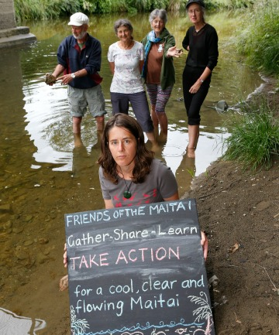
Friends of the Maitai Reformed 2014
Vision: taking action for a cool, clear, clean, flowing Maitai River
Fairfax Media NZ / Nelson Mail
www.friendsofthemaitai.org.nz

Slide 9
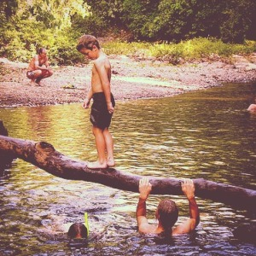
Friends of the Maitai
Memories book
Quote “I remember regular family picnics and swimming in the river- from 1950s on. I remember my mother always beat me into the water- she wasn't afraid of cold water- right up to the last years of her life- she still beat me into the river.”

Slide 10
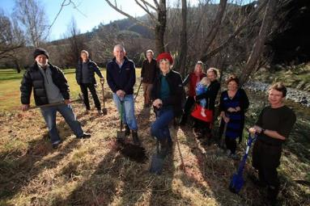
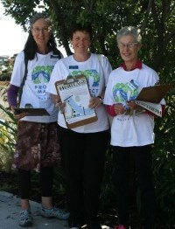
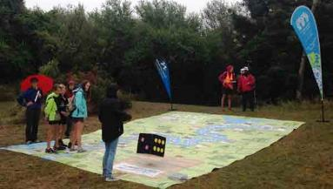
Friends of the Maitai
Values include :
Rivers and streams are connected living entities
Working with people’s strengths and interests
Focusing on long term solutions
Taking action, observing, recording and reflecting which deepens the group’s knowledge of the catchment ecology and civic participation

Slide 11
Project Maitai/Mahitahi was designed to:
incorporate community input at the programme development stage and then throughout the whole project management process;
make a flexible and responsive structure that could allow the programme to respond to community values and priorities the Council may not have recognised;
build relationships between the different Council business units and contractors working in and around our waterways, as well as with external stakeholders.

Slide 12
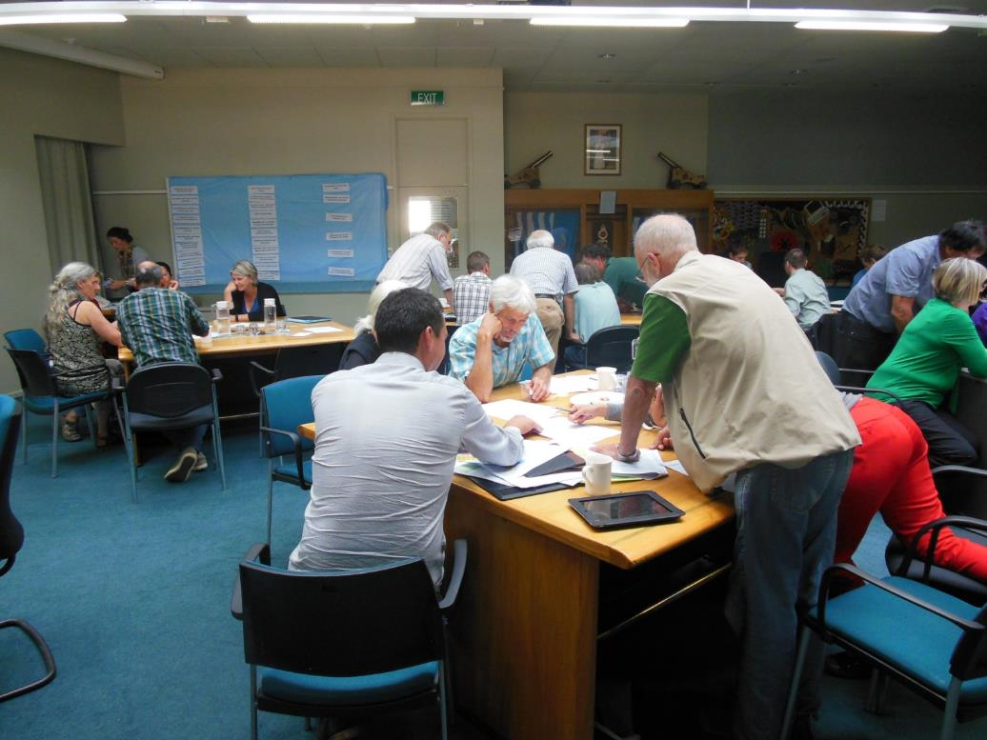
The Programme is developed each year with stakeholder input.

Slide 13
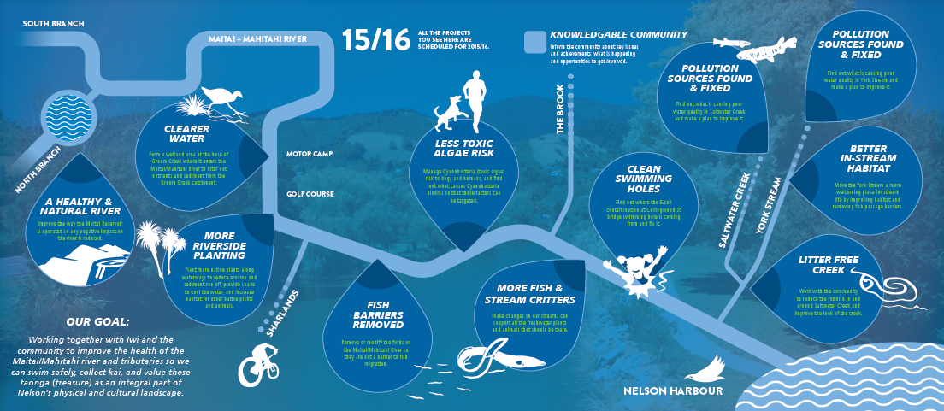
It’s a mix of Council-focused and community-focused projects.

Slide 14
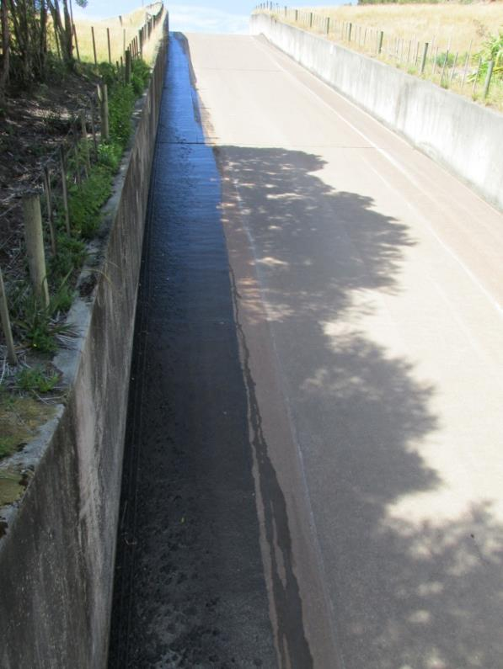
So what have we learnt so far?
Elvers can climb a 150m long wetted spat rope up a spillway and it takes them 5 days to do it!

Slide 15
It’s important to align participation expectations with what is feasible.
Good science and planning is vital - not ‘paralysis by analysis’.
Engage with those doing the delivery - to make real change we have to change the way things are done!
Clearly identify both the ‘decision maker’ and the ‘driver’. Who has mandate? Who has resources?

Slide 16
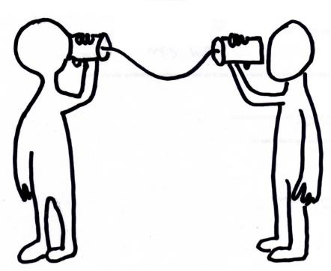
Friends of the Maitai
Learnings (1)
Finding out how the Council works can be difficult
There are many communication paths and they are all important
Information can be difficult to acquire
Adaptation is vital

Slide 17
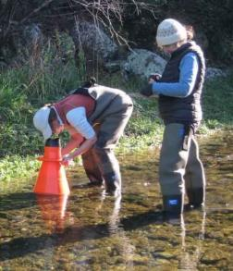
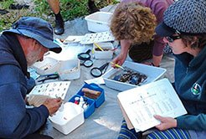
Friends of the Maitai
Learnings (2)
Scale is important
Dreams and details are both very important
Working with people helps us to appreciate the work that they do
Land use practices have a large effect on the ecology of the river

Slide 18
It’s difficult to plan, manage and implement an urban waterway improvement project with full community participation.
But its worth trying because:
people are interested and they want to help
we have to change to make change
we’re all in this together
if the elvers can make that much effort so can we ☺

Slide 19
Acknowledgements
Friends of the Maitai, especially the Kennedys, David Ayre and Alison Horn
The Iwi representatives who carry the knowledge of those who first knew the river
The Mayor and Nelson City Councillors, officers, contractors and community volunteers who support the programme with their passion and enthusiasm.
The freshwater scientists at the Cawthron Institute
The Project Maitai/Mahitahi stakeholder group

